Slide 1
3-1 ANALOG AND DIGITAL
To be transmitted, data must be transformed to electromagnetic signals
Data can be analog or digital.. The term analog data refers to information that is continuous; digital data refers to information that has discrete states. Analog data take on continuous values.. Digital data take on discrete values..
Data can be analog or digital.
Analog data are continuous and take continuous values.
Digital data have discrete states and take discrete values.
Signals can be analog or digital.
Analog signals can have an infinite number of values in a range; digital signals can have only a limited number of values.
3.1

Slide 2
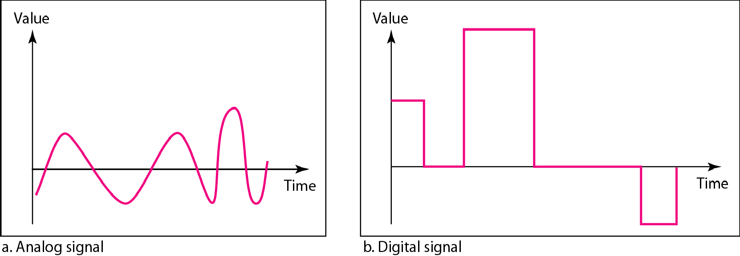
Figure 3.1 Comparison of analog and digital signals
In data communications, we commonly use periodic analog signals and
nonperiodic digital signals.
3.2

Slide 3
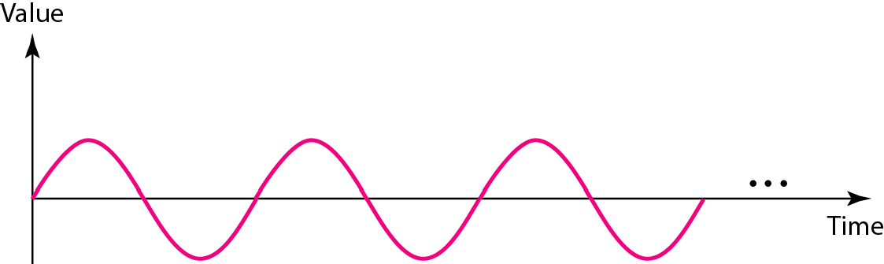
Figure 3.2 A sine wave
3.3

Slide 4

Example 3.1
The power in your house can be represented by a sine wave with a peak amplitude of 155 to 170 V. However, it is common knowledge that the voltage of th power in
U.S. homes is 110 to 120 V. This discrepancy is due to the fact that these are root mean square (rms) values The signal is squared and then the average amplitude is calculated The peak value is equal to 2^{½} × rms value

Slide 5
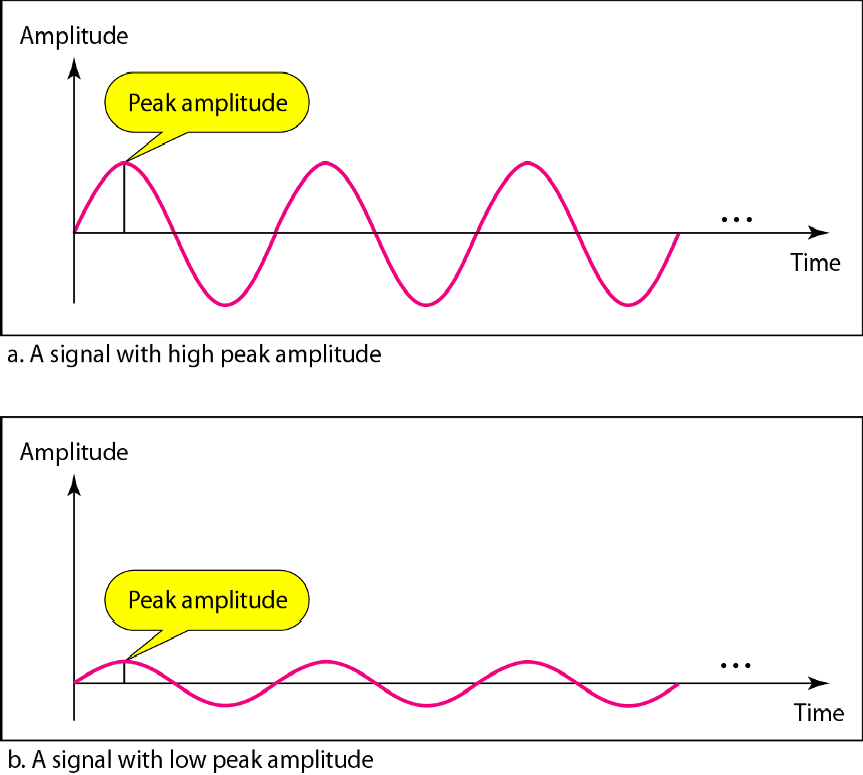
Figure 3.3 Two signals with the same phase and frequency, but different amplitudes

Slide 6
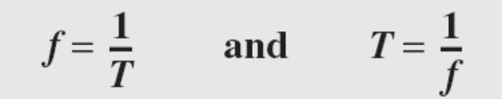
Example 3.2
The voltage of a battery is a constant; this constant value can be considered a sine wave, as we will see later. For example, th peak value of an A batter is normally
1.5 V.
Frequency and period are the inverse of
each other.

Slide 7
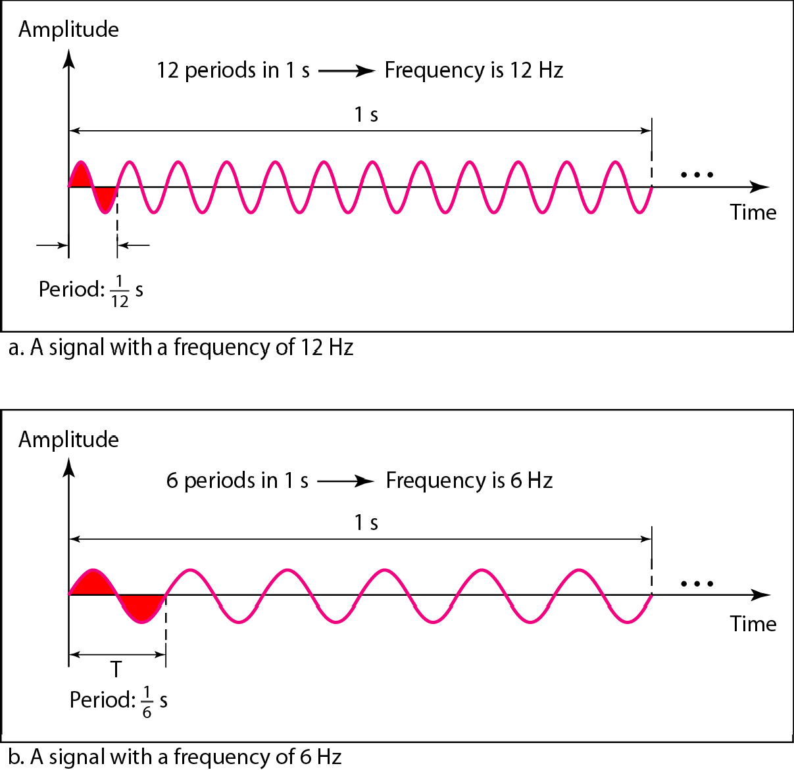
Figure 3.4 Two signals with the same amplitude and phase, but different frequencies

Slide 8
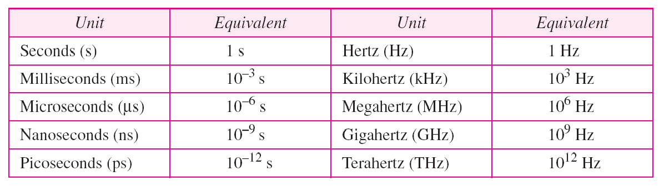
Table 3.1 Units of period and frequency

Slide 9
Example 3.3
The power we use at home has a frequency of 60 Hz. The period of this sine wave can be determined as follows:

Slide 10
Example 3.4
Express a period of 100 ms in microseconds.
Solution
From Table 3.1 we find the equivalents of 1 ms (1 ms is 10⁻³ s) and 1 s (1 s is 10⁶ μs). We make the following substitutions:.

Slide 11

Example 3.5
The period of a signal is 100 ms. What is its frequency in kilohertz?
Solution
First we change 100 ms to seconds, and then we calculate the frequency from the period (1 Hz = 10⁻³ kHz).

Slide 12
Frequency is the rate of change with respect to time. Change in a short span of time means high frequency. Change over a long span of time means low frequency.
If a signal does not change at all, its frequency is zero.
If a signal changes instantaneously, its frequency is infinite.
Phase describes the position of the waveform relative to time 0.

Slide 13
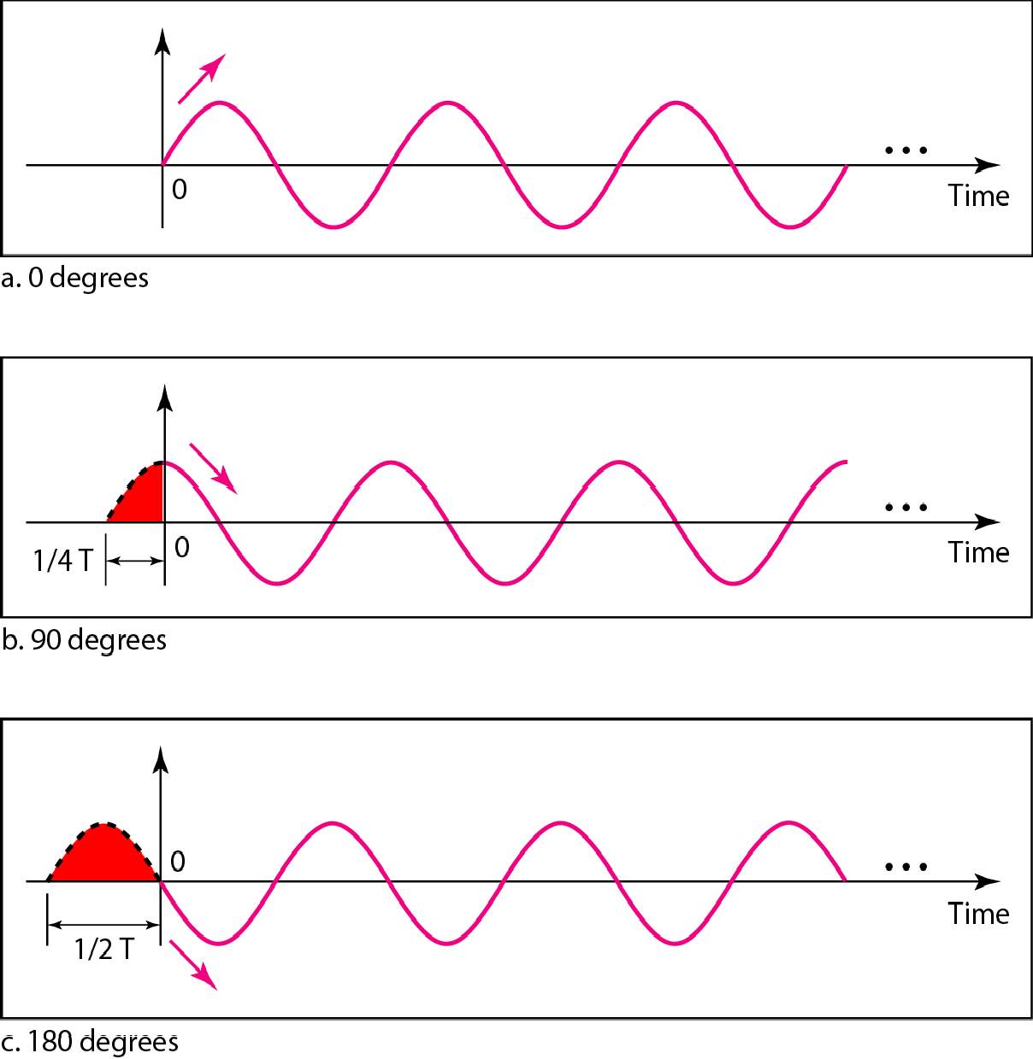
Figure 3.5 Three sine waves with the same amplitude and frequency, but different phases

Slide 14
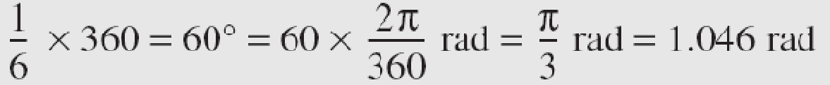
Example 3.6
sine wave is offset 1/6 cycle with respect to time 0.
What is its phase in degrees and radians?
Solution
We know that 1 complete cycle is 360°. Therefore, 1/6 cycle is

Slide 15
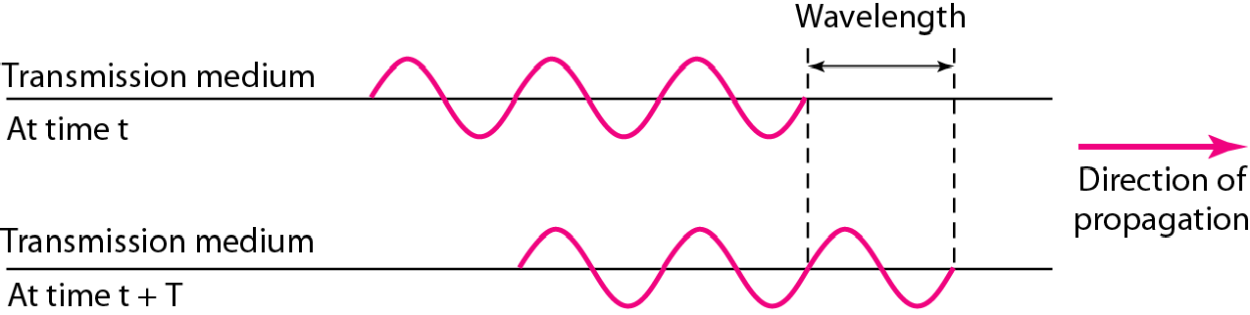
Figure 3.6 Wavelength and period

Slide 16
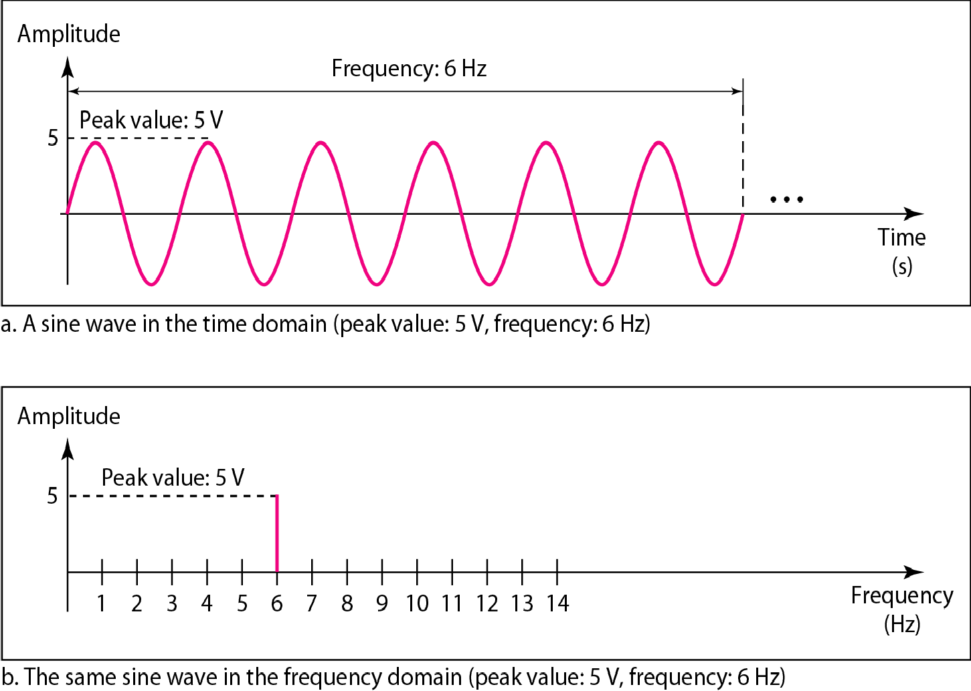
Figure 3.7 The time-domain and frequency-domain plots of a sine wave

Slide 17
Note
A complete sine wave in the time domain can be represented by one single spike in the frequency domain.

Slide 18
Example 3.7
The frequency domain is more compact and useful when we are dealing with more than one sine wave. For example, Figure 3.8 shows three sine waves, each with different amplitude and frequency. All can be represented by three spikes in the frequency domain.

Slide 19
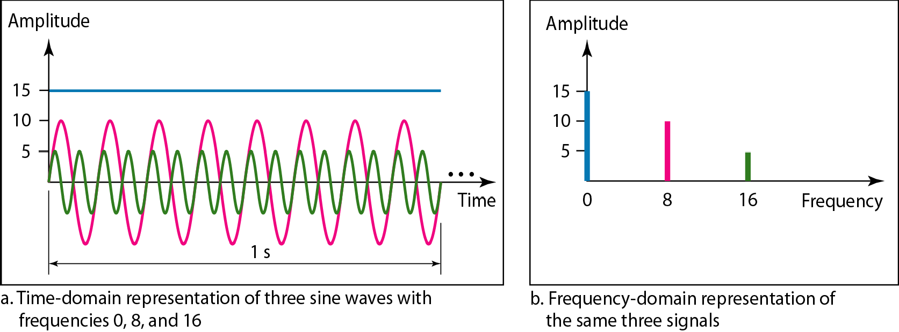
Figure 3.8 The time domain and frequency domain of three sine waves

Slide 20
A single-frequency sine wave is not useful in data communications;
we need to send a composite signal, a signal made of many simple sine waves.
According to Fourier analysis, any composite signal is a combination of simple sine waves with different frequencies, amplitudes, and phases.
Fourier analysis is discussed in Appendix C.
If the composite signal is periodic, the decomposition gives a series of signals with discrete frequencies;
if the composite signal is nonperiodic, the decomposition gives a combination of sine waves with continuous frequencies.

Slide 21
Example 3.8
Figure 3.9 shows a periodic composite signal with frequency f. This type of signal is not typical of those found in data communications We can consider it to be three alarm systems, each with a different frequency. The analysis of this signal can give us a good understanding of how to decompose signals.

Slide 22
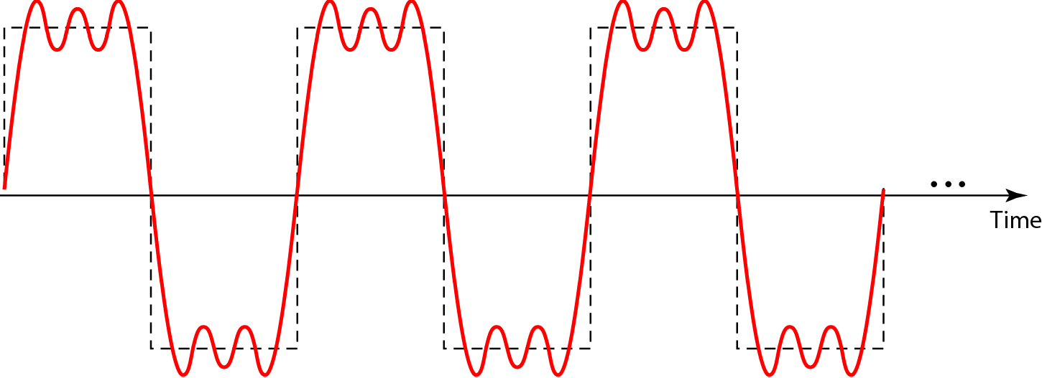
Figure 3.9 A composite periodic signal

Slide 23
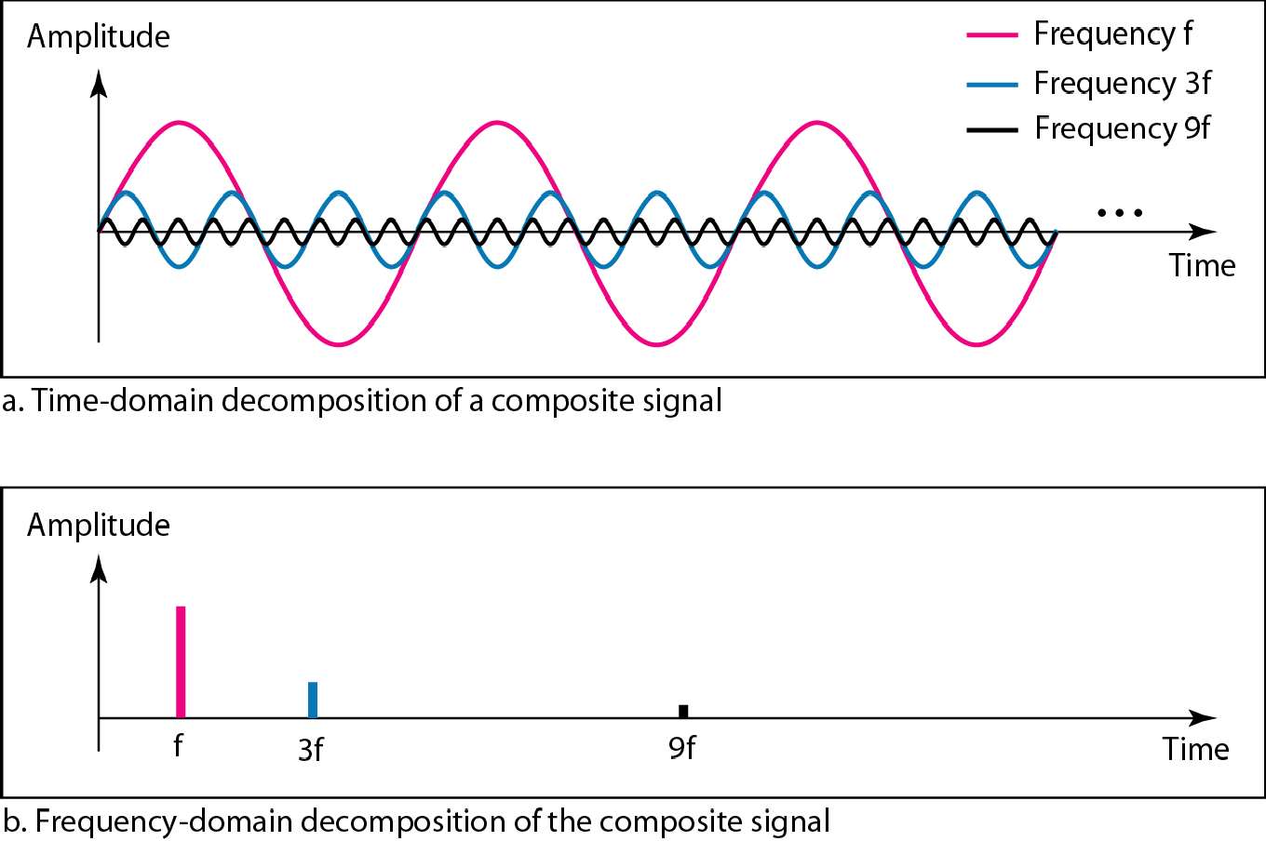
Figure 3.10 Decomposition of a composite periodic signal in the time and frequency domains

Slide 24
Example 3.9
Figure 3.11 shows a nonperiodic composite signal. It can be the signal created by a microphone or a telephone set when a word or two is pronounced In thi case, the composite signal cannot be periodic, because that implies that we are repeating the same word or words with exactly the same tone.

Slide 25
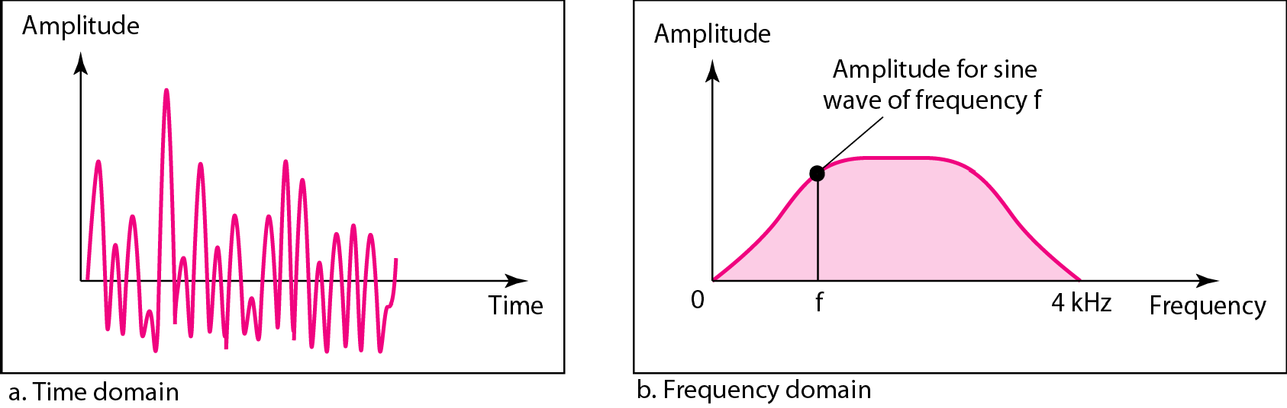
Figure 3.11 The time and frequency domains of a nonperiodic signal

Slide 26

Note
The bandwidth of a composite signal is the difference between the
highest and the lowest frequencies contained in that signal.

Slide 27
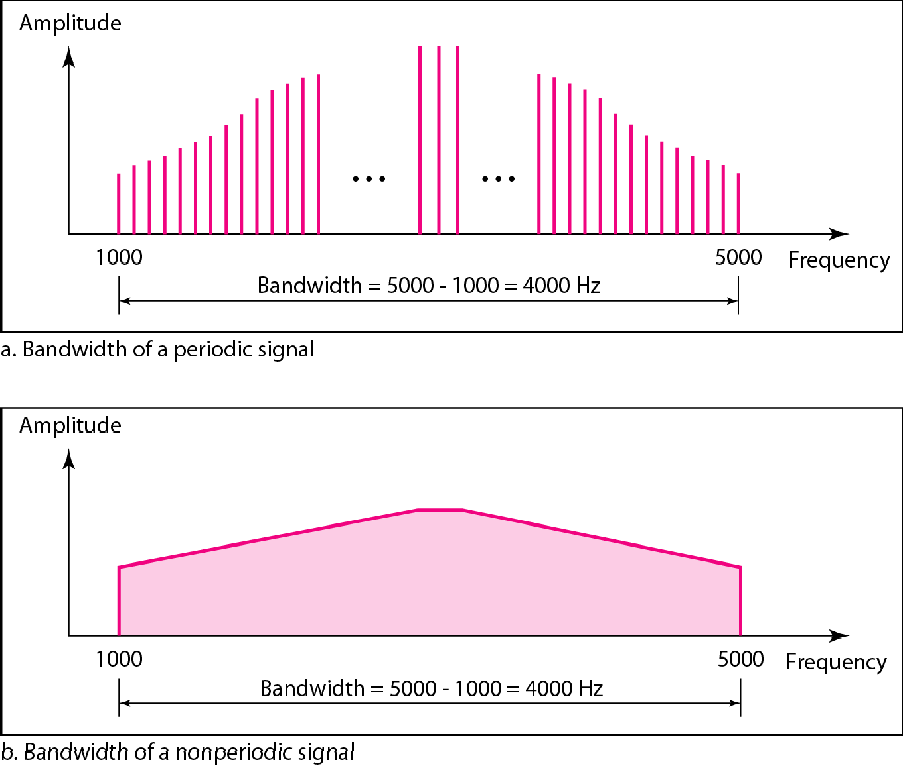
Figure 3.12 The bandwidth of periodic and nonperiodic composite signals

Slide 28

Example 3.10
If a periodic signal is decomposed into five sine waves with frequencies of 100, 300, 500, 700, and 900 Hz, what is its bandwidth? Draw the spectrum, assuming all components have a maximum amplitude of 10 V. Solution
Let f_{h} be the highest frequency, f_{l} the lowest frequency, and B the bandwidth. Then
The spectrum has only five spikes, at 100, 300, 500, 700,
and 900 Hz (see Figure 3.13).

Slide 29
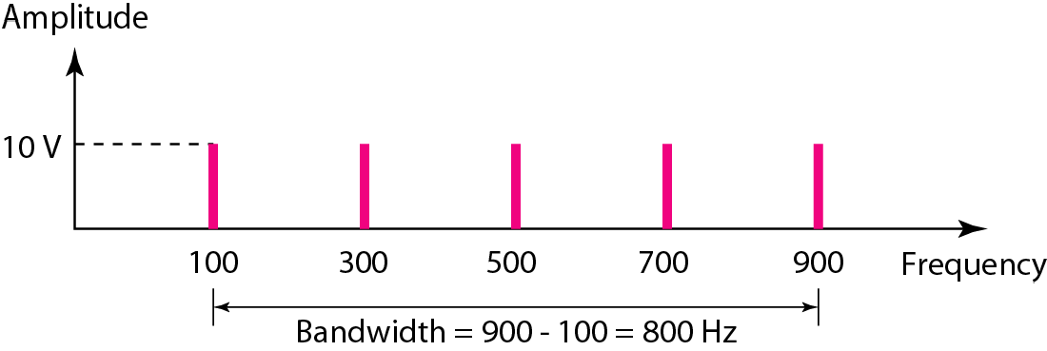
Figure 3.13 The bandwidth for Example 3.10

Slide 30
Example 3.11
A periodic signal has a bandwidth of 20 Hz. The highest frequency is 60 Hz. What is the lowest frequency? Draw the spectrum if the signal contains all frequencies of the same amplitude.
Solution
Let f_{h} be the highest frequency, f_{l} the lowest frequency, and B the bandwidth. Then
The spectrum contains all integer frequencies. We show this by a series of spikes (see Figure 3.14).

Slide 31
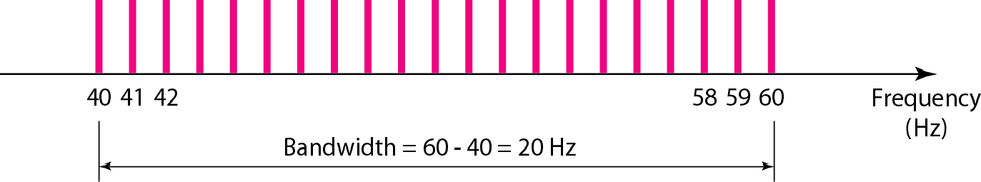
Figure 3.14 The bandwidth for Example 3.11

Slide 32
Example 3.12
nonperiodic composite signal has a bandwidth of 200 kHz, with a middle frequency of 140 kHz and peak amplitude of 20 V The two extreme frequencies have an amplitude of 0. Draw the frequency domain of the signal
Solution
The lowest frequency must be at 40 kHz and the highest at 240 kHz Figure 3 15 shows the frequency domain and the bandwidth.

Slide 33
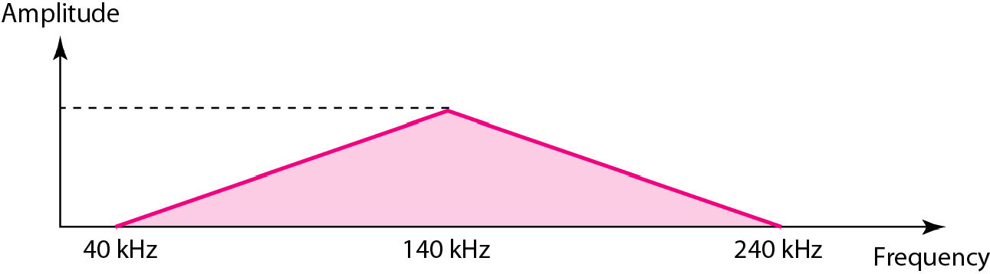
Figure 3.15 The bandwidth for Example 3.12

Slide 34
Example 3.13
An example of a nonperiodic composite signal is the signal propagated by an AM radio station. In the United States, each AM radio station is assigned a 10-kHz bandwidth. The total bandwidth dedicated to AM radio ranges from 530 to 1700 kHz. We will show the rationale behind this 10-kHz bandwidth in Chapter 5.

Slide 35
Example 3.14
Another example of a nonperiodic composite signal is the signal propagated by an FM radio station. In the United States, each FM radio station is assigned a 200- kHz bandwidth. The total bandwidth dedicated to FM radio ranges from 88 to 108 MHz We will show the rationale behind this 200-kHz bandwidth in Chapter 5.

Slide 36
Example 3.15
Another example of a nonperiodic composite signal is the signal received by an old-fashioned analog black- and-white TV. A TV screen is made up of pixels. If we assume a resolution of 525 × 700, we have 367,500 pixels per screen. If we scan the screen 30 times per second, this is 367,500 × 30 = 11,025,000 pixels per second. The worst-case scenario is alternating black and white pixels. We can send 2 pixels per cycle. Therefore, we need 11,025,000 / 2 = 5,512,500 cycles per second, or Hz. The bandwidth needed is 5.5125 MHz.

Slide 37
3-3 DIGITAL SIGNALS
In addition to being represented by an analog signal, information can also be represented by a digital signal.... For example, a 1 can be encoded as a positive voltage and a 0 as zero voltage.... A digital signal can have more than two levels. In this case, we can send more than 1 bit for each level....
Topics discussed in this section:
Bit Rate Bit Length
Digital Signal as a Composite Analog Signal Application Layer

Slide 38
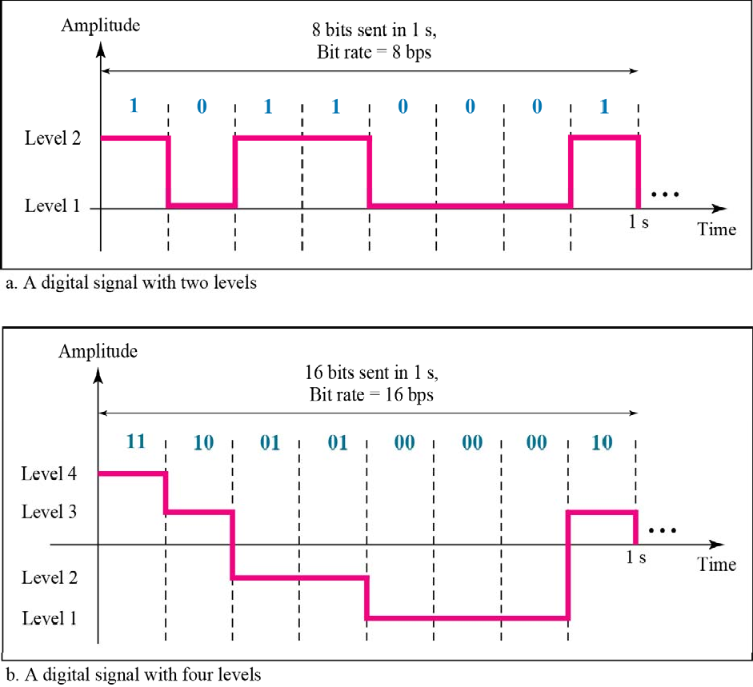
Figure 3.16 Two digital signals: one with two signal levels and the other with four signal levels

Slide 39
Example 3.16
digital signal has eight levels. How many bits are needed per level? We calculate the number of bits from the formula
Each signal level is represented by 3 bits.

Slide 40
Example 3.17
digital signal has nine levels. How many bits are needed per level? We calculate the number of bits by using the formula Each signal level is represented by
3.17 bits. However, this answer is not realistic. The number of bits sent per level needs to be an integer as well as a power of 2. For this example, 4 bits can represent one level

Slide 41
Example 3.18
Assume we need to download text documents at the rate of 100 pages per second. What is the required bit rate of the channel?
Solution
page is an average of 24 lines with 80 characters in each line. If we assume that one character requires 8 bits, the bit rate is

Slide 42
Example 3.19
A digitized voice channel, as we will see in Chapter 4, is made by digitizing a 4-kHz bandwidth analog voice signal. We need to sample the signal at twice the highest frequency (two samples per hertz). We assume that each sample requires 8 bits. What is the required bit rate?
Solution
The bit rate can be calculated as

Slide 43
Example 3.20
What is the bit rate for high-definition TV (HDTV)?
Solution
HDTV uses digital signals to broadcast high quality video signals. The HDTV screen is normally a ratio of 16 : 9. There are 1920 by 1080 pixels per screen, and the screen is renewed 30 times per second. Twenty-four bits represents one color pixel.
The TV stations reduce this rate to 20 to 40 Mbps through compression.

Slide 44
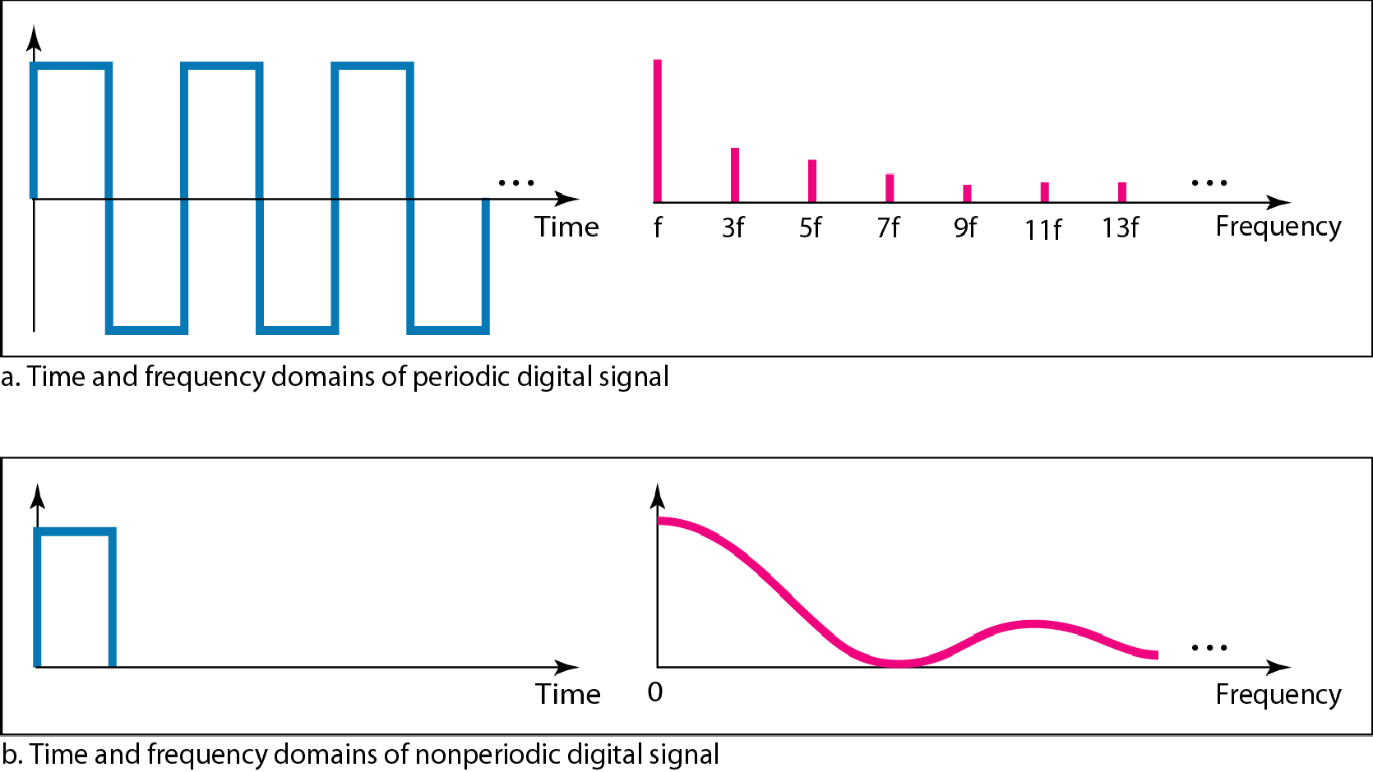
Figure 3.17 The time and frequency domains of periodic and nonperiodic digital signals

Slide 45
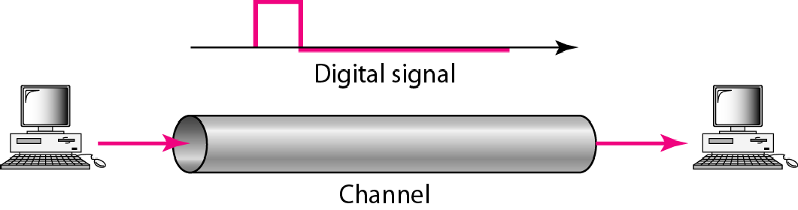
Figure 3.18 Baseband transmission
A digital signal is a composite analog
signal with an infinite bandwidth.

Slide 46
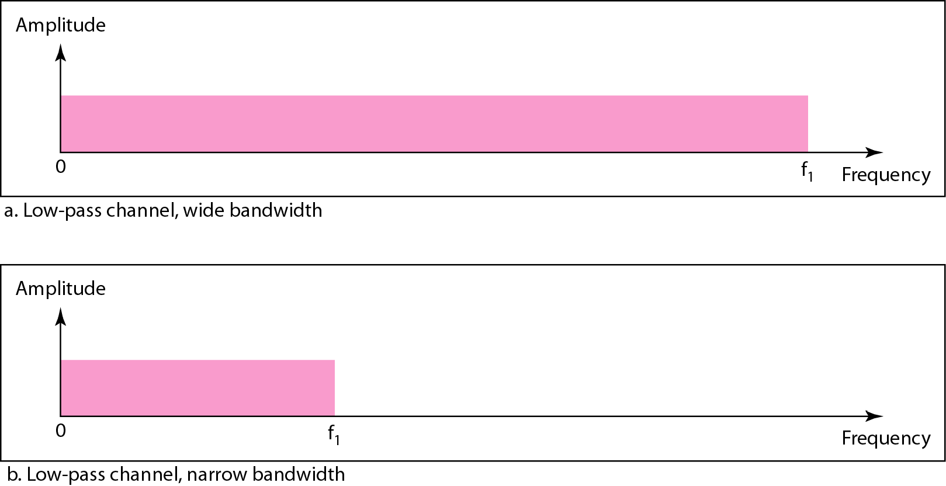
Figure 3.19 Bandwidths of two low-pass channels

Slide 47
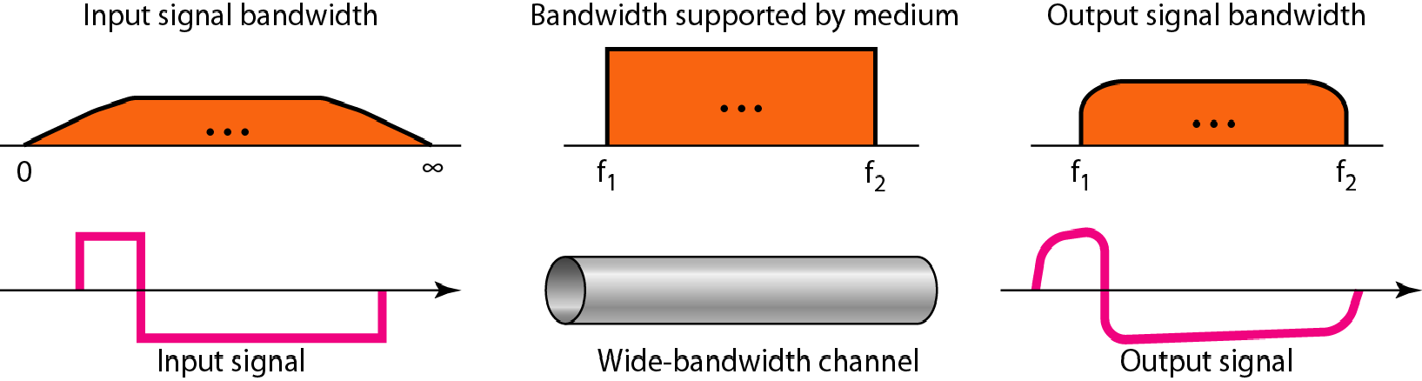
Figure 3.20 Baseband transmission using a dedicated medium

Slide 48
Note
Baseband transmission of a digital signal that preserves the shape of the digital signal is possible only if we have a low-pass channel with an infinite or
very wide bandwidth.

Slide 49
Example 3.21
An example of a dedicated channel where the entire bandwidth of the medium is used as one single channel is a LAN. Almost every wired LAN today uses a dedicated channel for two stations communicating with each other. In a bus topology LAN with multipoint connections, only two stations can communicate with each other at each moment in time (timesharing); the other stations need to refrain from sending data. In a star topology LAN, the entire channel between each station and the hub is used for communication between these two entities. We study LANs in Chapter 14.

Slide 50
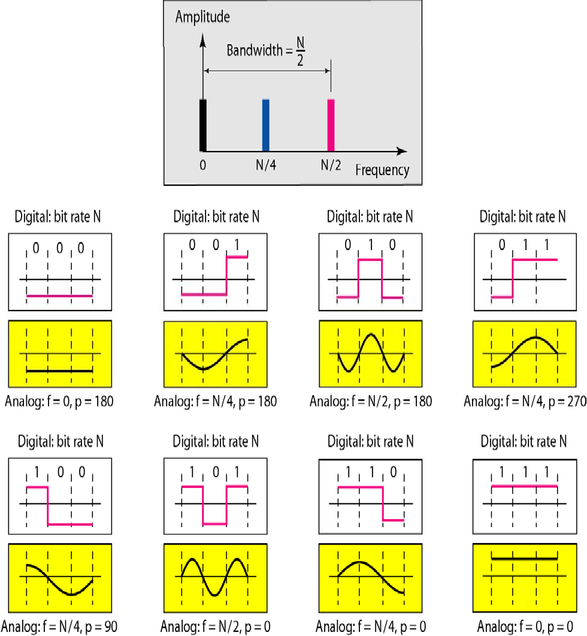
Figure 3.21 Rough approximation of a digital signal using the first harmonic for worst case

Slide 51
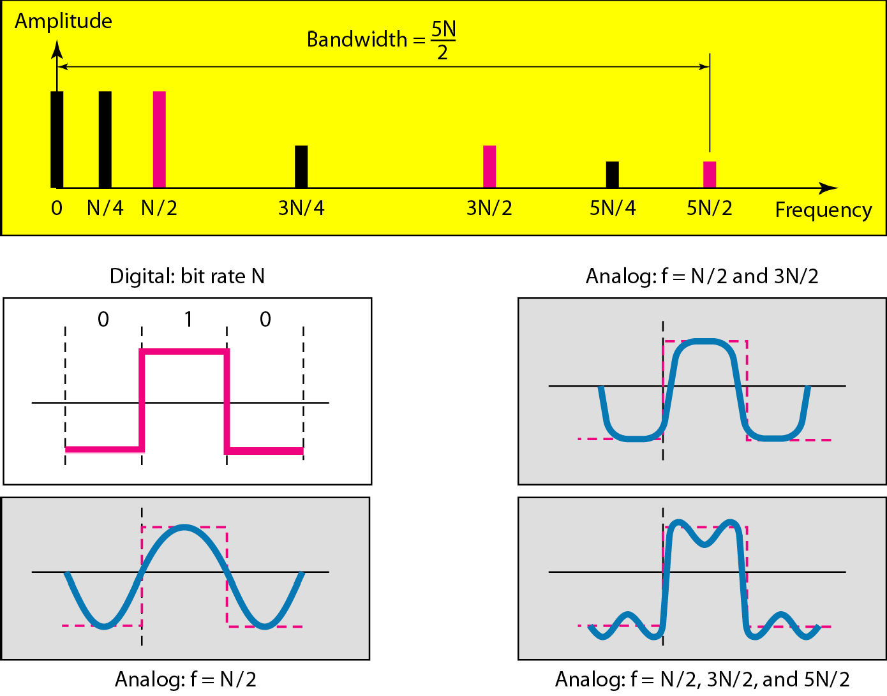
Figure 3.22 Simulating a digital signal with first three harmonics

Slide 52
In baseband transmission, the required bandwidth is
proportional to the bit rate;
if we need to send bits faster, we need more bandwidth.
if we need to send bits faster, we need
more bandwidth.

Slide 53
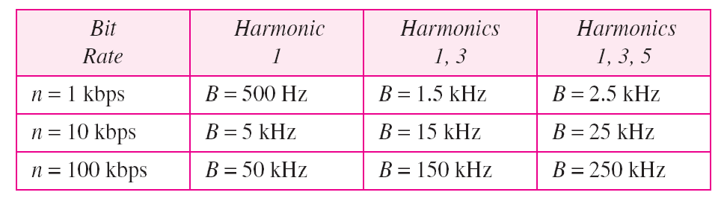
Table 3.2 Bandwidth requirements

Slide 54
Example 3.22
What is the required bandwidth of a low-pass channel if we need to send 1 Mbps by using baseband transmission?
Solution
The answer depends on the accuracy desired.
The minimum bandwidth, is B = bit rate /2, or 500 kHz.
A better solution is to use the first and the third harmonics with B = 3 × 500 kHz = 1.5 MHz.
Still a better solution is to use the first, third, and fifth harmonics with B = 5 × 500 kHz = 2.5 MHz.

Slide 55
Example 3.22
We have a low-pass channel with bandwidth 100 kHz.
What is the maximum bit rate of this
channel?
Solution
The maximum bit rate can be achieved if we use the first harmonic. The bit rate is 2 times the available bandwidth, or 200 kbps.

Slide 56
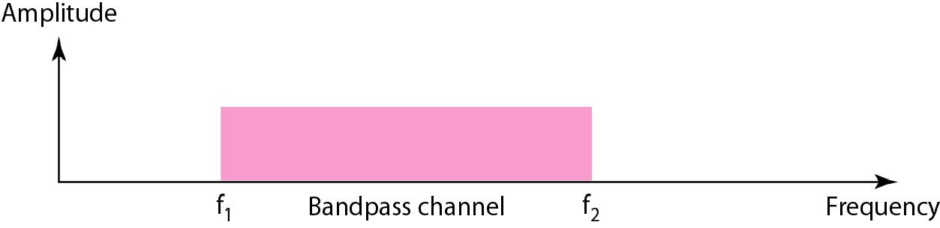
Figure 3.23 Bandwidth of a bandpass channel

Slide 57

Note
If the available channel is a bandpass channel, we cannot send the digital signal directly to the channel;
we need to convert the digital signal to an analog signal before transmission.

Slide 58
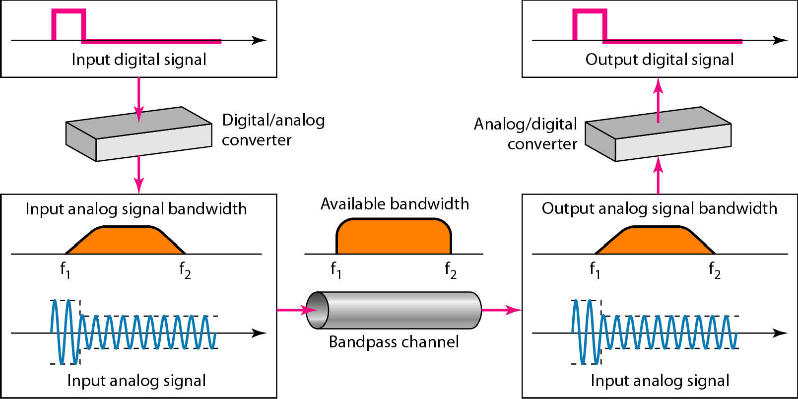
Figure 3.24 Modulation of a digital signal for transmission on a bandpass channel

Slide 59
Example 3.24
An example of broadband transmission using modulation is the sending of computer data through a telephone subscriber line, the line connecting a resident to the central telephone office. These lines are designed to carry voice with a limited bandwidth. The channel is considered a bandpass channel. We convert the digital signal from the computer to an analog signal, and send the analog signal. We can install two converters to change the digital signal to analog and vice versa at the receiving end. The converter, in this case, is called a modem which we discuss in detail in Chapter 5.

Slide 60
Example 3.25
second example is the digital cellular telephone. For better reception, digital cellular phones convert the analog voice signal to a digital signal (see Chapter 16) Although the bandwidth allocated to a company providing digital cellular phone service is very wide, we still cannot send the digital signal without conversion. The reason is that we only have a bandpass channel available between caller and callee. We need to convert the digitized voice to a composite analog signal before sending.

Slide 61
3-4 TRANSMISSION IMPAIRMENT
Signals travel through transmission media, which are not perfect.. The imperfection causes signal impairment.. This means that the signal at the beginning of the medium is not the same as the signal at the end of the medium.. What is sent is not what is received. Three causes of impairment are attenuation,, distortion,, and noise..
Topics discussed in this section:
Attenuation Distortion Noise

Slide 62
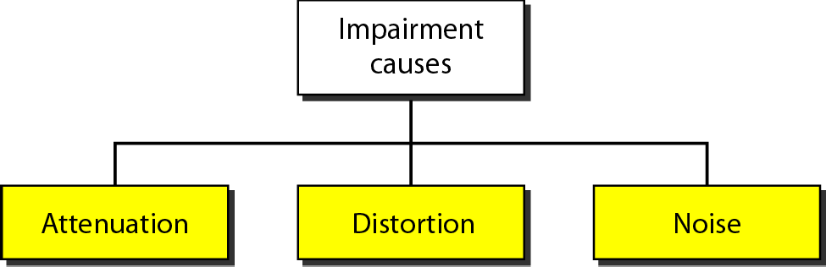
Figure 3.25 Causes of impairment

Slide 63
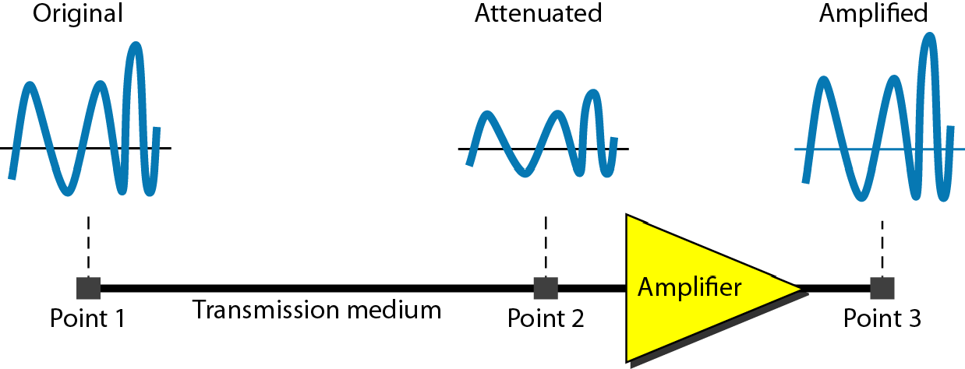
Figure 3.26 Attenuation

Slide 64
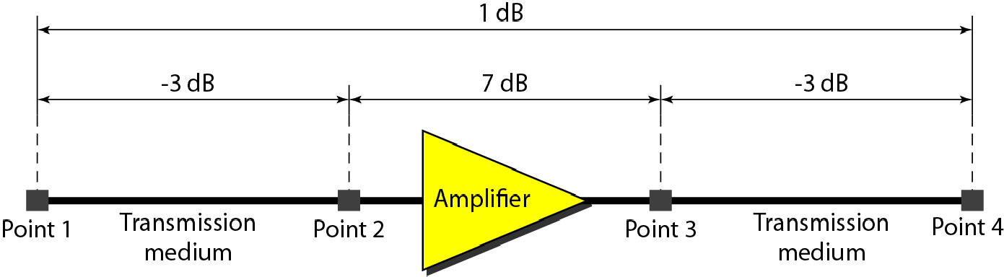
Figure 3.27 Decibels for Example 3.28

Slide 65
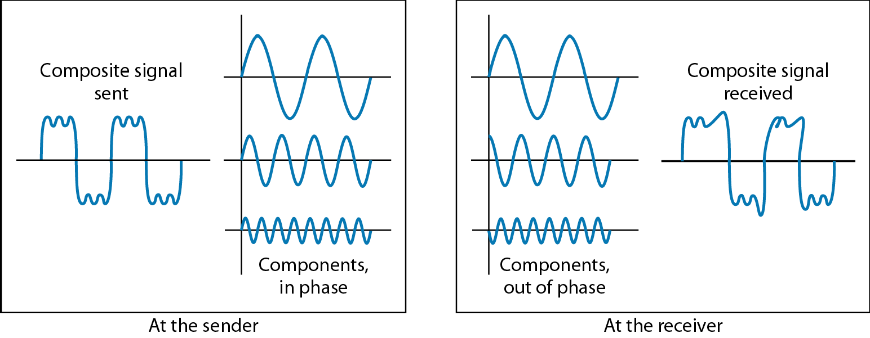
Figure 3.28 Distortion

Slide 66
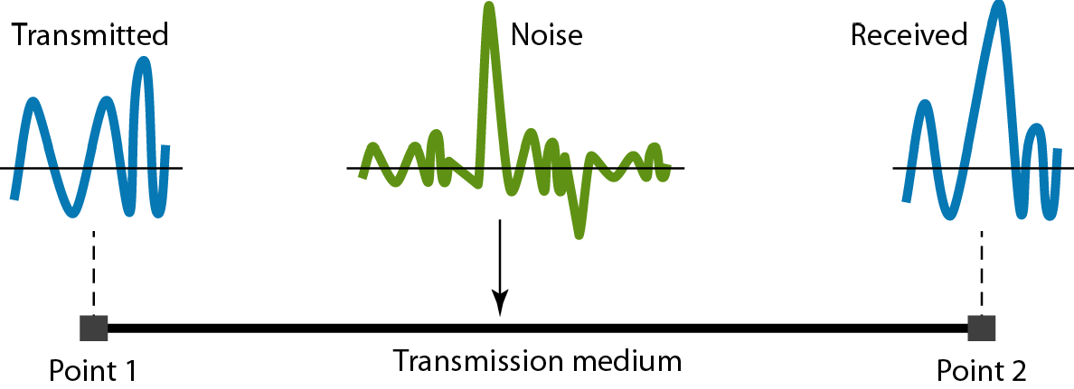
Figure 3.29 Noise

Slide 67
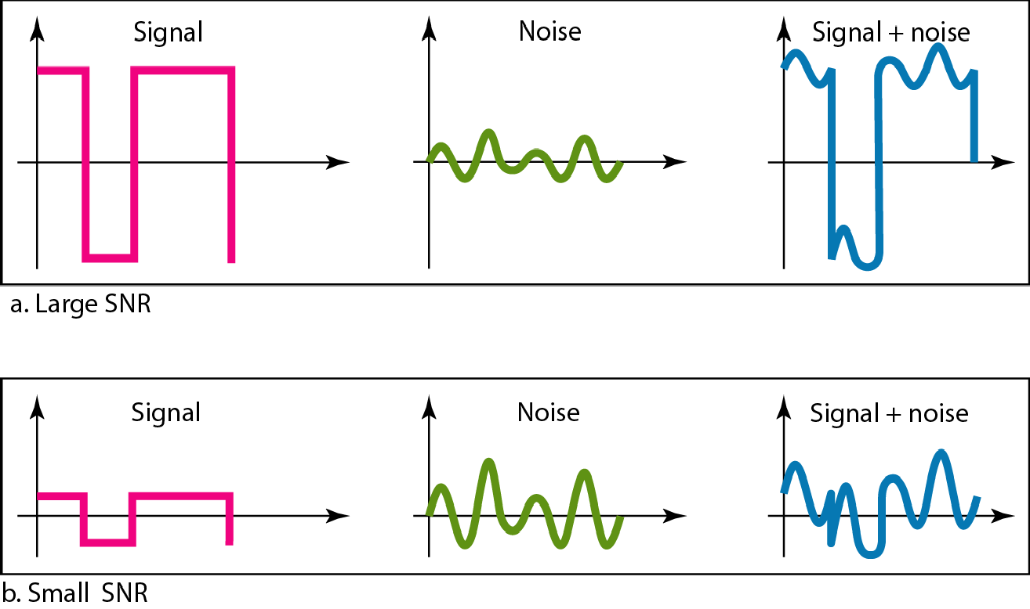
Figure 3.30 Two cases of SNR: a high SNR and a low SNR

Slide 68
3-5 DATA RATE LIMITS
A very important consideration in data communications is how fast we can send data, in bits per second, over a channel. Data rate depends on three factors:
1.. The bandwidth available
2. The level of the signals we use
3.. The quality of the channel (the level of noise)
Increasing the levels of a signal may reduce the reliability of the system.

Slide 69
Example 3.33
Does the Nyquist theorem bit rate agree with the intuitive bit rate described in baseband transmission?
Solution
They match when we have only two levels We said, in baseband transmission, the bit rate is 2 times the bandwidth if we use only the first harmonic in the worst case. However, the Nyquist formula is more general than what we derived intuitively; it can be applied to baseband transmission and modulation. Also, it can be applied when we have two or more levels of signals

Slide 70
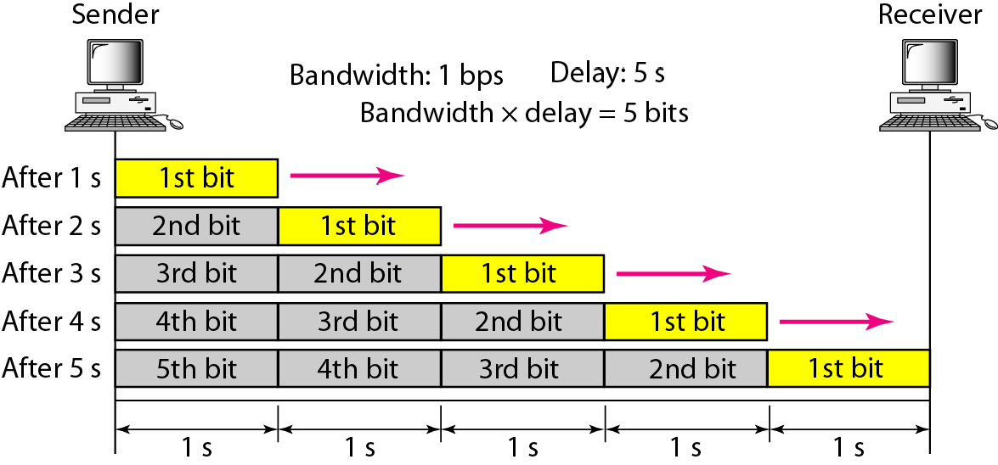
Figure 3.31 Filling the link with bits for case 1
3.70

Slide 71
Example 3.48
We can think about the link between two points as a pipe. The cross section of the pipe represents the bandwidth, and the length of th pipe represents th delay. We can say the volume of the pipe defines the bandwidth-delay product, as shown in Figure 3 33
3.71

Slide 72
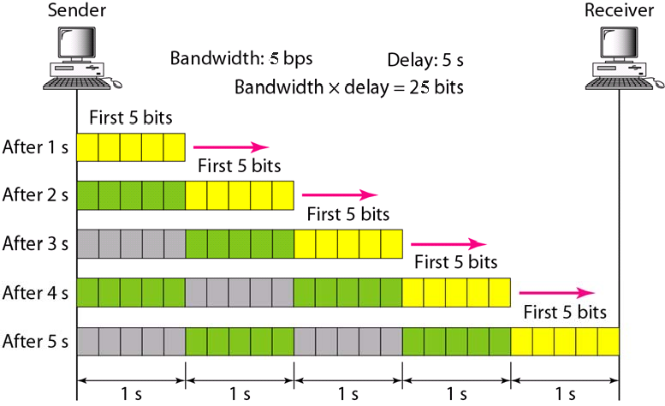
Figure 3.32 Filling the link with bits in case 2
3.72

Slide 73

Figure 3.33 Concept of bandwidth-delay product
The bandwidth-delay product defines the number of bits that can fill the link
3.73

Slide 74
4-1 DIGITAL-TO-DIGITAL CONVERSION
In this section, we see how we can represent digital data by using digital signals. The conversion involves
three techniques: line coding,, block coding,,
and block
scrambling.. Line coding is always needed;
coding and scrambling may or may not be needed..
Topics discussed in this section:
Line Coding
Line Coding Schemes Block Coding Scrambling
4.2

Slide 75
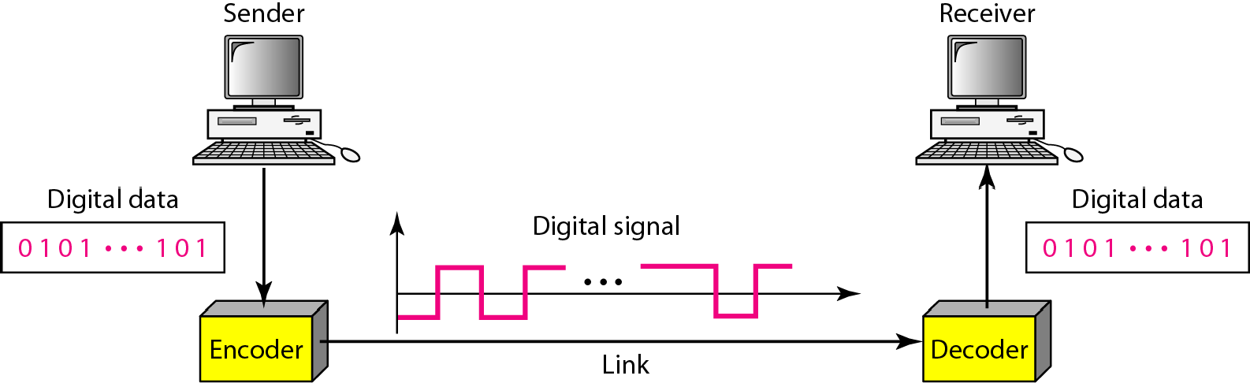
Figure 4.1 Line coding and decoding
4.3

Slide 76
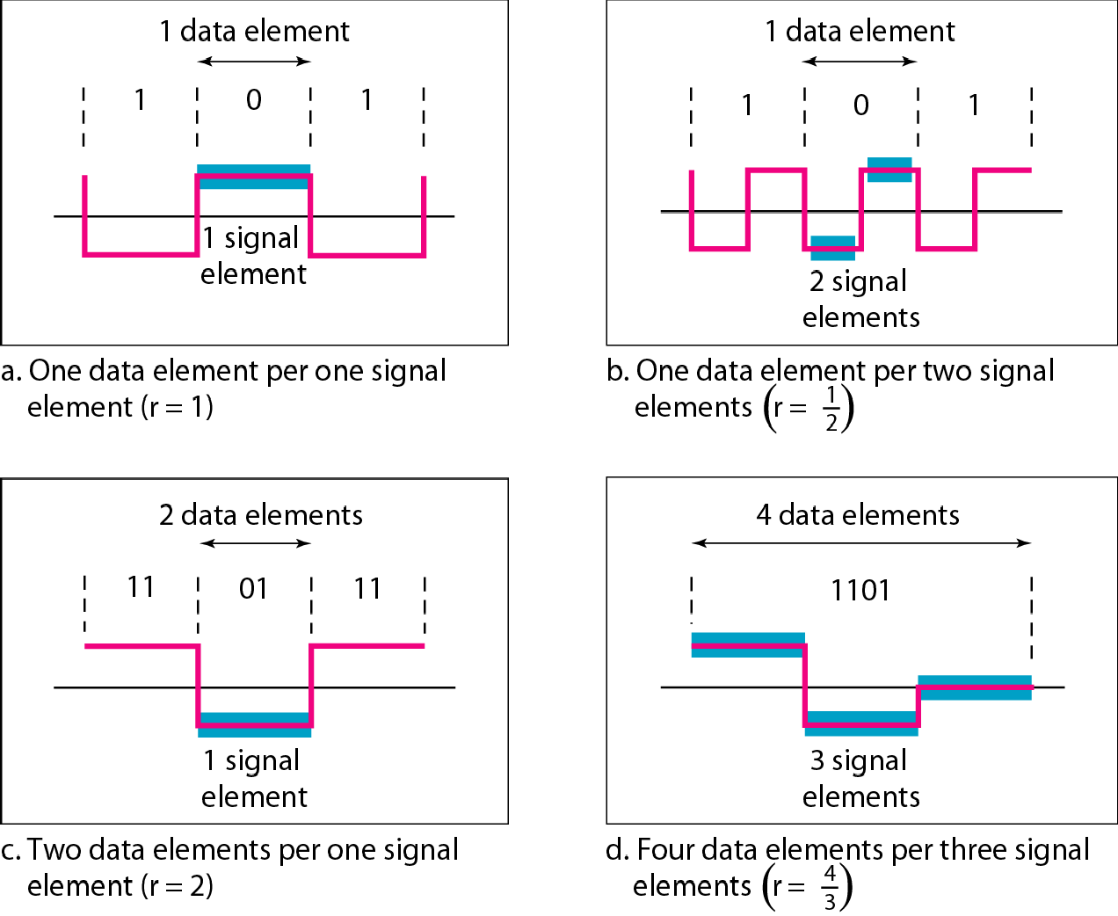
Figure 4.2 Signal element versus data element
4.4

Slide 77
Note
Although the actual bandwidth of a digital signal is infinite, the effective bandwidth is finite.
4.6

Slide 78
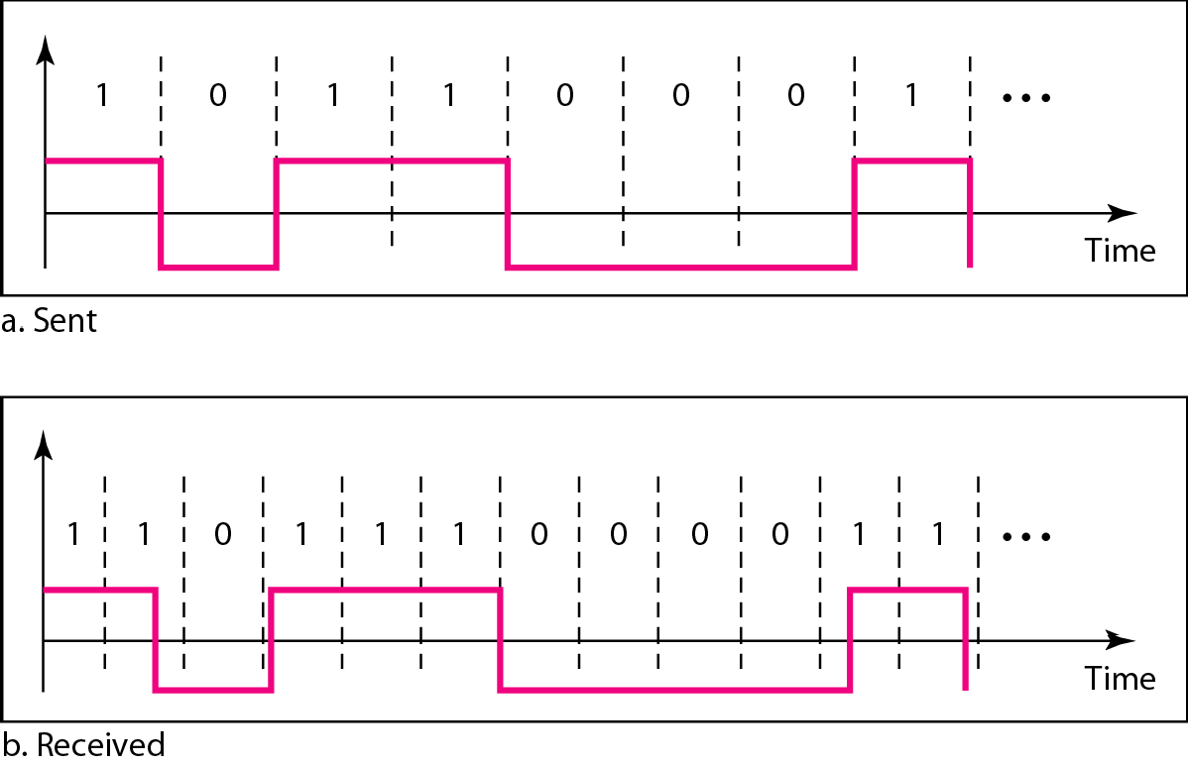
Figure 4.3 Effect of lack of synchronization
4.8

Slide 79
Example 4.3
In a digital transmission, the receiver clock is 0.1 percent faster than the sender clock. How many extra bits per second does the receiver receive if the data rate is 1 kbps? How many if the data rate is 1 Mbps?
Solution
At 1 kbps, the receiver receives 1001 bps instead of 1000 bps.
At 1 Mbps, the receiver receives 1,001,000 bps instead of 1,000,000 bps.
4.9

Slide 80
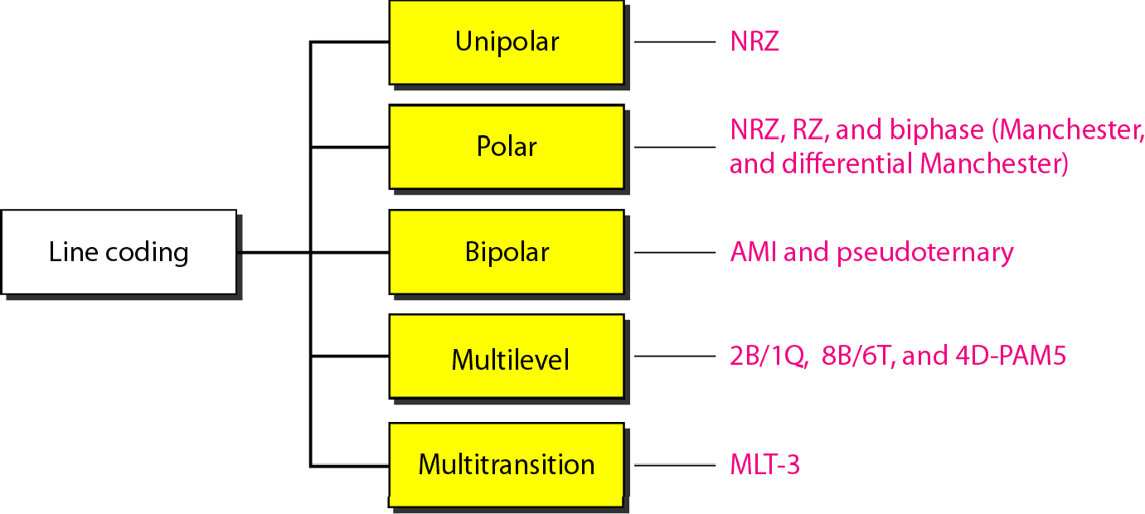
Figure 4.4 Line coding schemes

Slide 81
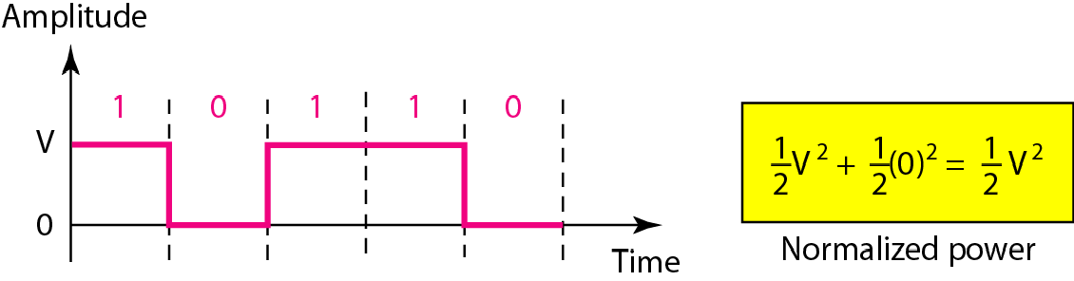
Figure 4.5 Unipolar NRZ scheme

Slide 82
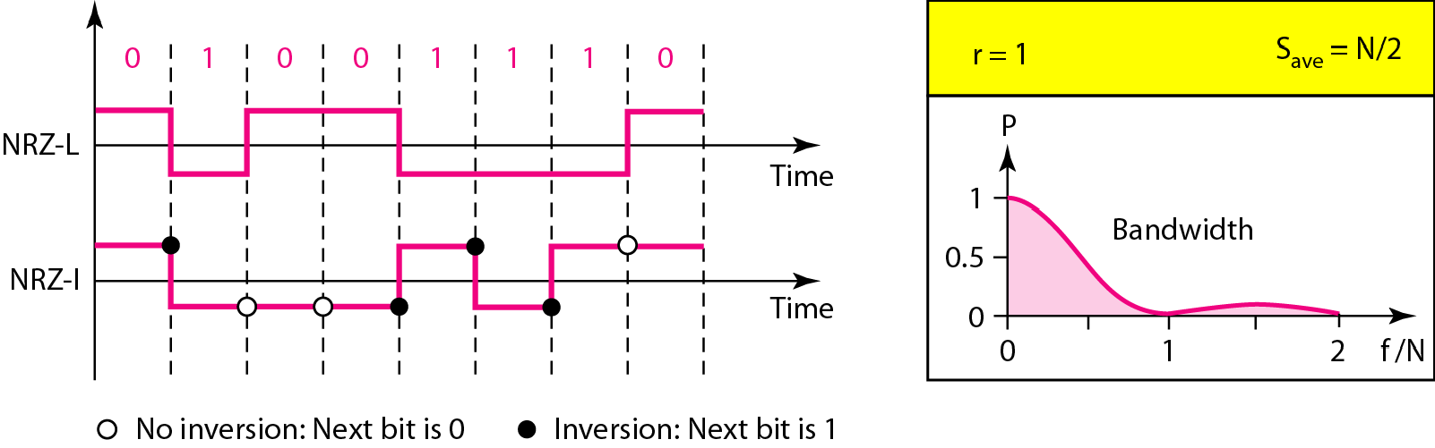
Figure 4.6 Polar NRZ-L and NRZ-I schemes

Slide 83
In NRZ-L the level of the voltage determines the value of the bit.
In NRZ-I the inversion or the lack of inversion
determines the value of the bit.
NRZ-L and NRZ-I both have an average signal rate of N/2 Bd.
NRZ-L and NRZ-I both have a DC component problem.

Slide 84
Example 4.4
A system is using NRZ-I to transfer 1-Mbps data. What are the average signal rate and minimum bandwidth?
Solution
The average signal rate is S = N/2 = 500 kbaud. The minimum bandwidth for this average baud rate is B_{min} = S = 500 kHz.

Slide 85
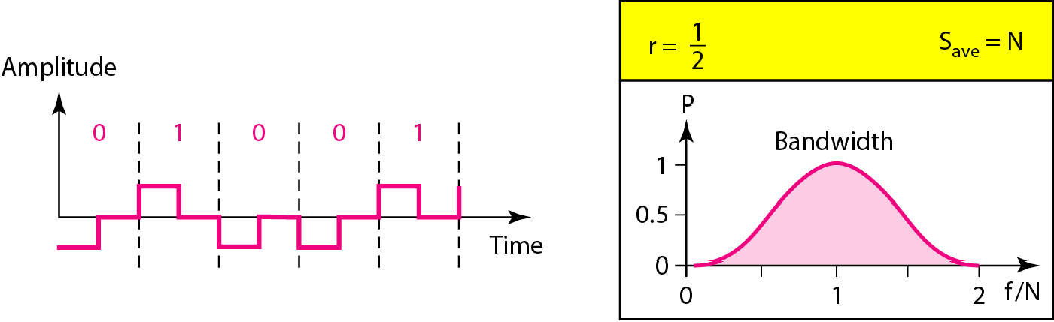
Figure 4.7 Polar RZ scheme

Slide 86
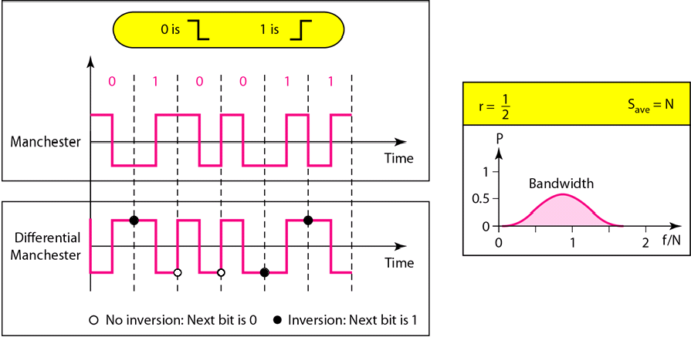
Figure 4.8 Polar biphase: Manchester and differential Manchester schemes

Slide 87
In Manchester and differential Manchester encoding, the transition at the middle of the bit is used for synchronization.
The minimum bandwidth of Manchester and differential Manchester is 2 times that of NRZ.
In bipolar encoding, we use three levels: positive, zero, and negative.

Slide 88
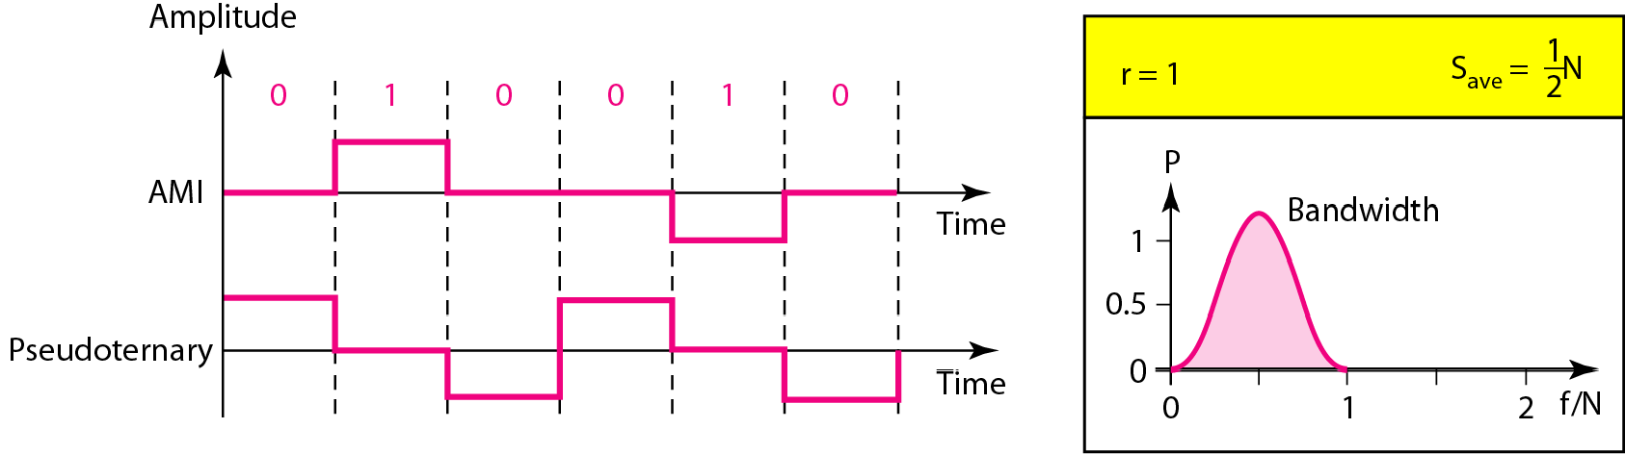
Figure 4.9 Bipolar schemes: AMI and pseudoternary

Slide 89
Note
In mBnL schemes, a pattern of m data elements is encoded as a pattern of n signal elements in which 2^{m} ≤ L^{n}.

Slide 90
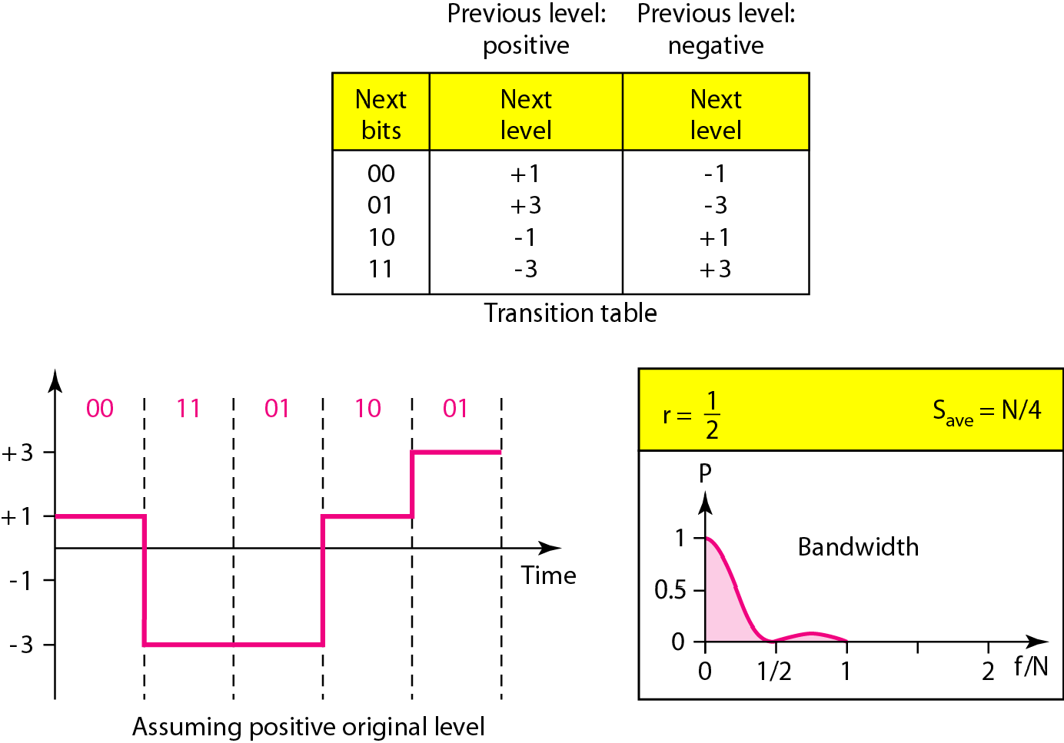
Figure 4.10 Multilevel: 2B1Q scheme

Slide 91
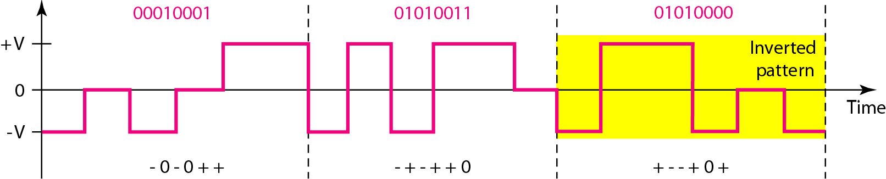
Figure 4.11 Multilevel: 8B6T scheme

Slide 92
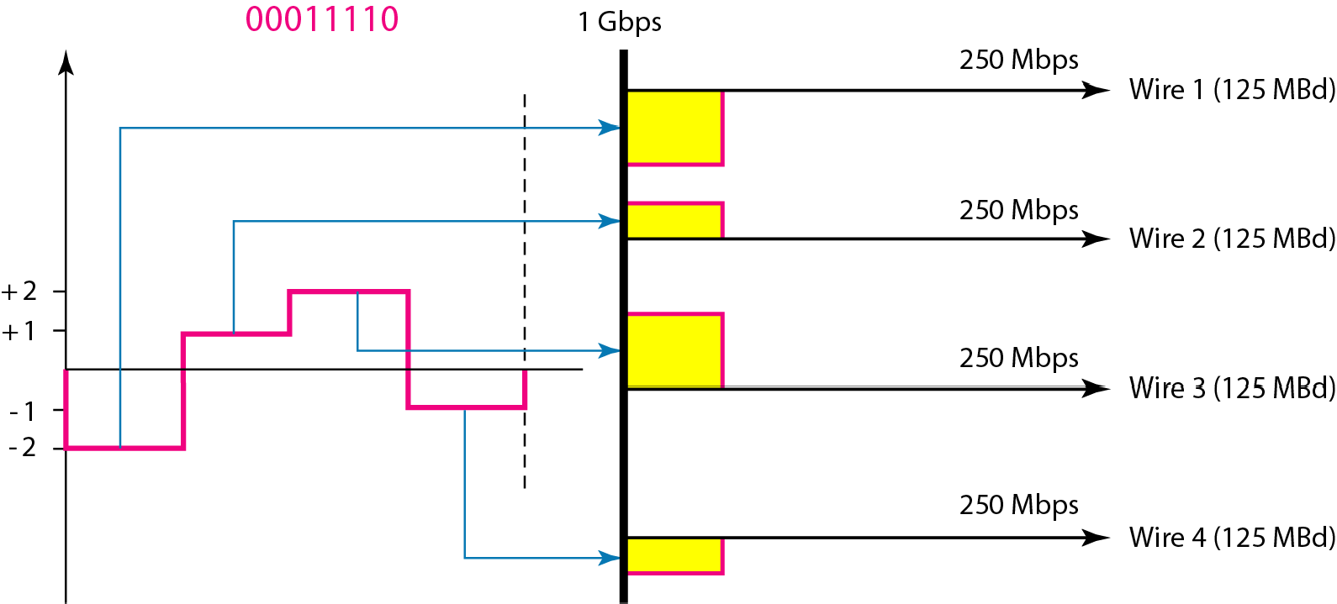
Figure 4.12 Multilevel: 4D-PAM5 scheme

Slide 93
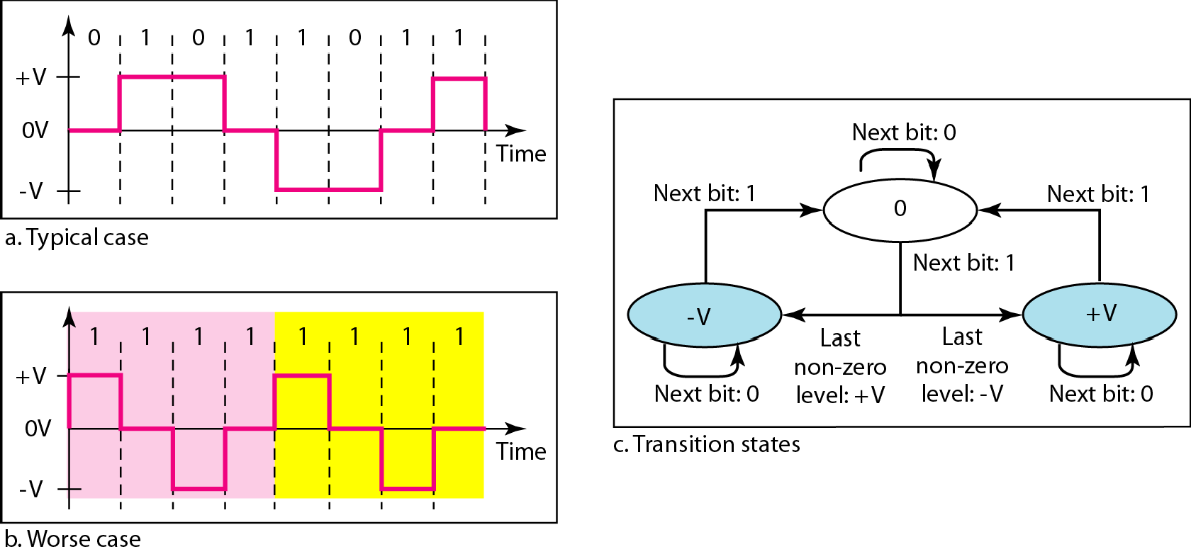
Figure 4.13 Multitransition: MLT-3 scheme

Slide 94
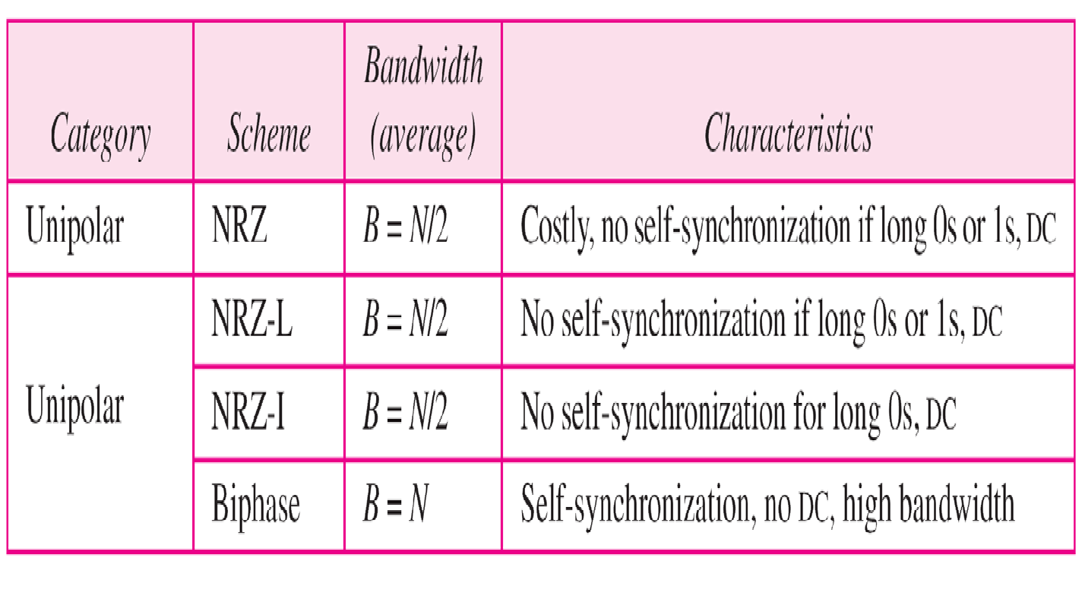

Table 4.1 Summary of line coding schemes

Slide 95
Note
Block coding is normally referred to as
mB/nB coding;
it replaces each m-bit group with an
n-bit group.

Slide 96

Figure 4.14 Block coding concept

Slide 97

Figure 4.15 Using block coding 4B/5B with NRZ-I line coding scheme

Slide 98


Table 4.2 4B/5B mapping codes

Slide 99

Figure 4.16 Substitution in 4B/5B block coding

Slide 100
Example 4.5
We need to send data at a 1-Mbps rate. What is the minimum required bandwidth, using a combination of 4B/5B and NRZ-I or Manchester coding?
Solution
First 4B/5B block coding increases the bit rate to 1.25 Mbps. The minimum bandwidth using NRZ-I is N/2 or 625 kHz. The Manchester scheme needs a minimum bandwidth of 1 MHz. The first choice needs a lower bandwidth, but has a DC component problem; the second choice needs a higher bandwidth, but does not have a DC component problem

Slide 101

Figure 4.17 8B/10B block encoding

Slide 102

Figure 4.18 AMI used with scrambling

Slide 103

Figure 4.19 Two cases of B8ZS scrambling technique

Slide 104
Note
B8ZS substitutes eight consecutive zeros with 000VB0VB.

Slide 105

Figure 4.20 Different situations in HDB3 scrambling technique

Slide 106
Note
HDB3 substitutes four consecutive zeros with 000V or B00V depending on the number of nonzero pulses after the last substitution.

Slide 107
4-2 ANALOG-TO-DIGITAL CONVERSION
We have seen in Chapter 3 that a digital signal is superior to an analog signal. The tendency today is to change an analog signal to digital data.. In this section we describe two techniques, pulse code modulation and delta modulation..
Topics discussed in this section: Pulse Code Modulation (PCM) Delta Modulation (DM)

Slide 108

Figure 4.21 Components of PCM encoder

Slide 109

Figure 4.22 Three different sampling methods for PCM

Slide 110
Note
According to the Nyquist theorem, the sampling rate must be
at least 2 times the highest frequency contained in the signal.

Slide 111

Figure 4.23 Nyquist sampling rate for low-pass and bandpass signals

Slide 112
Example 4.6
For an intuitive example of the Nyquist theorem, let us sample a simple sine wave at three sampling rates: f_{s} = 4f (2 times the Nyquist rate), f_{s} = 2f (Nyquist rate), and f_{s} = f (one-half the Nyquist rate). Figure 4.24 shows the sampling and the subsequent recovery of the signal.
It can be seen that sampling at the Nyquist rate can create a good approximation of the original sine wave (part a).
Oversampling in part
b can also create the same is redundant and unnecessary.
approximation, but it
Sampling below the Nyquist rate (part c) does not produce a signal that looks like the original sine wave.

Slide 113

Figure 4.24 Recovery of a sampled sine wave for different sampling rates

Slide 114
Example 4.7
Consider the revolution of a hand of a clock. The second hand of a clock has a period of 60 s. According to the Nyquist theorem, we need to sample the hand every 30 s (T_{s} = T or f_{s} = 2f ). In Figure 4.25a, the sample points, in order, are 12, 6, 12, 6, 12, and 6. The receiver of the samples cannot tell if the clock is moving forward or backward. In part b, we sample at double the Nyquist rate (every 15 s). The sample points are 12, 3, 6, 9, and 12. The clock is moving forward. In part c, we sample below the Nyquist rate (T_{s} = T or f_{s} = f ). The sample points are 12, 9, 6, 3, and 12. Although the clock is moving forward, the receiver thinks that the clock is moving backward.

Slide 115

Figure 4.25 Sampling of a clock with only one hand

Slide 116
Example 4.8
An example related to Example 4.7 is the seemingly backward rotation of the wheels of a forward-moving car in a movie. This can be explained by under-sampling. A movie is filmed at 24 frames per second. If a wheel is rotating more than 12 times per second, the under- sampling creates the impression of a backward rotation.
Telephone companies digitize voice by assuming a maximum frequency of 4000 Hz. The sampling rate therefore is 8000 samples per second.

Slide 117
Example 4.10
A complex low-pass signal has a bandwidth of 200 kHz. What is the minimum sampling rate for this signal?
Solution
The bandwidth of a low-pass signal is between 0 and f, where f is the maximum frequency in the signal Therefore, we can sample this signal at 2 times the highest frequency (200 kHz) The sampling rate is therefore 400,000 samples per second.

Slide 118
Example 4.11
A complex bandpass signal has a bandwidth of 200 kHz. What is the minimum sampling rate for this signal?
Solution
We cannot find the minimum sampling rate in this case because we do not know where the bandwidth starts or ends. We do not know the maximum frequency in the signal

Slide 119

Figure 4.26 Quantization and encoding of a sampled signal

Slide 120
Example 4.12
What is the SNR_{dB} in the example of Figure 4.26?
Solution
We can use the formula to find the quantization. We have eight levels and 3 bits per sample, so
SNR_{dB} = 6 02(3) + 1 76 = 19 82 dB
Increasing the number of levels increases the SNR.

Slide 121
Example 4.13
A telephone subscriber line must have an SNR_{dB} above
40. What is the minimum number of bits per sample?
Solution
We can calculate the number of bits as
Telephone companies usually assign 7 or 8 bits per sample.

Slide 122

Example 4.14
We want to digitize the human voice. What is the bit rate, assuming 8 bits per sample?
Solution
The human voice normally contains frequencies from 0 to 4000 Hz. So the sampling rate and bit rate are calculated as follows:

Slide 123

Figure 4.27 Components of a PCM decoder

Slide 124
Example 4.15
We have a low-pass analog signal of 4 kHz. If we send the analog signal, we need a channel with a minimum bandwidth of 4 kHz. If we digitize the signal and send 8 bits per sample, we need a channel with a minimum bandwidth of 8 × 4 kHz = 32 kHz.

Slide 125

Figure 4.28 The process of delta modulation

Slide 126

Figure 4.29 Delta modulation components

Slide 127

Figure 4.30 Delta demodulation components

Slide 128
4-3 TRANSMISSION MODES
The transmission of binary data across a link can be accomplished in either parallel or serial mode. In parallel mode, multiple bits are sent with each clock tick. In serial mode, 1 bit is sent with each clock tick. While there is only one way to send parallel data, there are three subclasses of serial transmission: asynchronous, synchronous, and isochronous..
Topics discussed in this section:
Parallel Transmission Serial Transmission

Slide 129

Figure 4.31 Data transmission and modes

Slide 130

Figure 4.32 Parallel transmission

Slide 131

Figure 4.33 Serial transmission

Slide 132
In asynchronous transmission, we send 1 start bit (0) at the beginning and 1 or more stop bits (1s) at the end of each byte. There may be a gap between
each byte.
Asynchronous here means “asynchronous at the byte level,” but the bits are still synchronized; their durations are the same.

Slide 133

Figure 4.34 Asynchronous transmission
In synchronous transmission, we send bits one after another without start or stop bits or gaps. It is the responsibility of the receiver to group the bits.

Slide 134

Figure 4.35 Synchronous transmission

Slide 135
5-1 DIGITAL-TO-ANALOG CONVERSION
Digital-to-analog conversion is the process of changing one of the characteristics of an analog signal based on the information in digital data..
Topics discussed in this section: Aspects of Digital-to-Analog Conversion Amplitude Shift Keying
Frequency Shift Keying Phase Shift Keying
Quadrature Amplitude Modulation
5.2

Slide 136

Figure 5.1 Digital-to-analog conversion
5.3

Slide 137

Figure 5.2 Types of digital-to-analog conversion
5.4

Slide 138

Note
Bit rate is the number of bits per second.
Baud rate is the number of signal elements per second.
In the analog transmission of digital data, the baud rate is less than
or equal to the bit rate.
5.5

Slide 139
Example 5.1
An analog signal carries 4 bits per signal element. If 1000 signal elements are sent per second, find the bit rate.
Solution
In this case, r = 4, S = 1000, and N is unknown. We can find the value of N from
5.6

Slide 140

Example 5.2
An analog signal has a bit rate of 8000 bps and a baud rate of 1000 baud. How many data elements are carried by each signal element? How many signal elements do we need?
Solution
In this example, S = 1000, N = 8000, and r and L are unknown. We find first the value of r and then the value of L.
5.7

Slide 141

Figure 5.3 Binary amplitude shift keying
5.8

Slide 142

Figure 5.4 Implementation of binary ASK
5.9

Slide 143
Example 5.3
We have an available bandwidth of 100 kHz which spans from 200 to 300 kHz. What are the carrier frequency and the bit rate if we modulated our data by using ASK with d = 1?
Solution
The middle of the bandwidth is located at 250 kHz. This means that our carrier frequency can be at f_{c} = 250 kHz. We can use the formula for bandwidth to find the bit rate (with d = 1 and r = 1).
5.10

Slide 144
Example 5.4
In data communications, we normally use full-duplex links with communication in both directions. We need to divide th bandwidth into two with two carrier frequencies, as shown in Figure 5.5. The figure shows
and the bandwidths. The available bandwidth for each
the positions of two carrier frequencies
direction is now 50 kHz, which leaves us with a data rate of 25 kbps in each direction.
5.11

Slide 145

Figure 5.5 Bandwidth of full-duplex ASK used in Example 5.4
5.12

Slide 146

Figure 5.6 Binary frequency shift keying
5.13

Slide 147
Example 5.5
We have an available bandwidth of 100 kHz which spans from 200 to 300 kHz. What should be the carrier frequency and the bit rate if we modulated our data by using FSK with d = 1?
Solution
This problem is similar to Example 5.3, but we are modulating by using FSK. The midpoint of the band is at 250 kHz. We choose 2Δf to be 50 kHz; this means
5.14

Slide 148

Figure 5.7 Bandwidth of MFSK used in Example 5.6
5.15

Slide 149
Example 5.6
We need to send data 3 bits at a time at a bit rate of 3 Mbps. The carrier frequency is 10 MHz. Calculate the number of levels (different frequencies), the baud rate, and the bandwidth.
Solution
We can have L = 23 = 8. The baud rate is S = 3 MHz/3 = 1000 Mbaud. This means that the carrier frequencies must be 1 MHz apart (2Δf = 1 MHz). The bandwidth is B
= 8 × 1000 = 8000. Figure 5.8 shows the allocation of frequencies and bandwidth.
5.16

Slide 150

Figure 5.8 Bandwidth of MFSK used in Example 5.6
5.17

Slide 151

Figure 5.9 Binary phase shift keying
5.18

Slide 152

Figure 5.10 Implementation of BASK
5.19

Slide 153

Figure 5.11 QPSK and its implementation
5.20

Slide 154
Example 5.7
Find the bandwidth for a signal transmitting at 12 Mbps for QPSK. The value of d = 0.
Solution
For QPSK, 2 bits is carried by one signal element. This means that r = 2. So the signal rate (baud rate) is S = N × (1/r) = 6 Mbaud. With a value of d = 0, we have B = S = 6 MHz.
5.21

Slide 155

Figure 5.12 Concept of a constellation diagram
5.22

Slide 156
Example 5.8
Show the constellation diagrams for an ASK (OOK), BPSK, and QPSK signals.
Solution
Figure 5.13 shows the three constellation diagrams.
5.23

Slide 157

Figure 5.13 Three constellation diagrams
5.24

Slide 158
Note
Quadrature amplitude modulation is a
combination of ASK and PSK.
5.25

Slide 159

Figure 5.14 Constellation diagrams for some QAMs
5.26

Slide 160
5-2 ANALOG AND DIGITAL
Analog-to-analog conversion is the representation of analog information by an analog signal. One may ask why we need to modulate an analog signal; it is already analog. Modulation is needed if the medium is bandpass in nature or if only a bandpass channel is available to us.
Topics discussed in this section:
Amplitude Modulation Frequency Modulation Phase Modulation
5.27

Slide 161

Figure 5.15 Types of analog-to-analog modulation
5.28

Slide 162

Figure 5.16 Amplitude modulation
5.29

Slide 163
Note
The total bandwidth required for AM can be determined
from the bandwidth of the audio signal: B_{AM} = 2B.
5.30

Slide 164

Figure 5.17 AM band allocation
5.31

Slide 165
Note
The total bandwidth required for FM can be determined from the bandwidth
of the audio signal: B_{FM} = 2(1 + β)B.
5.32

Slide 166

Figure 5.18 Frequency modulation
5.33

Slide 167

Figure 5.19 FM band allocation
5.34

Slide 168

Figure 5.20 Phase modulation
5.35

Slide 169
Note
The total bandwidth required for PM can be determined from the bandwidth
and maximum amplitude of the modulating signal:
B_{PM} = 2(1 + β)B.
5.36

Slide 170
Note
Bandwidth utilization is the wise use of available bandwidth to achieve specific goals.
Efficiency can be achieved by multiplexing; privacy and anti-jamming can be achieved by spreading.
6.2

Slide 171
6-1 MULTIPLEXING
Whenever the bandwidth of a medium linking two devices is greater than the bandwidth needs of the devices, the link can be shared. Multiplexing is the set of techniques that allows the simultaneous transmission of multiple signals across a single data link.. As data and telecommunications use increases, so does traffic.
Topics discussed in this section: Frequency-Division Multiplexing Wavelength-Division Multiplexing Synchronous Time-Division Multiplexing Statistical Time-Division Multiplexing
6.3

Slide 172

Figure 6.1 Dividing a link into channels
6.4

Slide 173

Figure 6.2 Categories of multiplexing
6.5

Slide 174

Figure 6.3 Frequency-division multiplexing
FDM is an analog multiplexing technique that combines analog signals.
6.6

Slide 175

Figure 6.4 FDM process
6.8

Slide 176

Figure 6.5 FDM demultiplexing example
6.9

Slide 177
Example 6.1
Assume that a voice channel occupies a bandwidth of 4 kHz. We need to combine three voice channels into a link with a bandwidth of 12 kHz, from 20 to 32 kHz. Show the configuration, using the frequency domain. Assume there are no guard bands.
Solution
We shift (modulate) each of the three voice channels to a different bandwidth, as shown in Figure 6.6. We use the 20- to 24-kHz bandwidth for the first channel, the 24- to 28-kHz bandwidth for the second channel, and the 28- to 32-kHz bandwidth for the third one. Then we combine them as shown in Figure 6.6.

Slide 178

Figure 6.6 Example 6.1

Slide 179
Example 6.2
Five channels, each with a 100-kHz bandwidth, are to be multiplexed together. What is the minimum bandwidth of th link if ther is a need for a guard band of 10 kHz between the channels to prevent interference?
Solution
For five channels, we need at least four guard bands. This means that the required bandwidth is at least
5 × 100 + 4 × 10 = 540 kHz,
as shown in Figure 6.7.

Slide 180

Figure 6.7 Example 6.2

Slide 181
Example 6.3
Four data channels (digital), each transmitting at 1 Mbps, use a satellite channel of 1 MHz. Design an appropriate configuration, using FDM
Solution
The satellite channel is analog. We divide it into four channels, each channel having a 250-kHz bandwidth. Each digital channel of 1 Mbps is modulated such that each 4 bits is modulated to 1 Hz. One solution is 16-QAM modulation. Figure 6.8 shows one possible configuration.

Slide 182

Figure 6.8 Example 6.3

Slide 183

Figure 6.9 Analog hierarchy

Slide 184
Example 6.4
The Advanced Mobile Phone System (AMPS) uses two bands The first band of 824 to 849 MHz is used for sending, and 869 to 894 MHz is used for receiving. Each user has a bandwidth of 30 kHz in each direction
How many people can use their cellular phones
simultaneously? Solution
Each band is 25 MHz. If we divide 25 MHz by 30 kHz, we
get 833.33. In reality, the band is divided into 832 channels. Of these, 42 channels are used for control, which means only 790 channels are available for cellular phone users.

Slide 185

Figure 6.10 Wavelength-division multiplexing

Slide 186

Note
WDM is an analog multiplexing technique to combine optical signals.

Slide 187

Figure 6.11 Prisms in wavelength-division multiplexing and demultiplexing

Slide 188

Figure 6.12 TDM
TDM is a digital multiplexing technique for combining several low-rate channels into one high-rate one.

Slide 189

Figure 6.13 Synchronous time-division multiplexing

Slide 190

Note
In synchronous TDM, the data rate of the link is n times faster, and the unit
duration is n times shorter.

Slide 191
Example 6.5
In Figure 6.13, the data rate for each input connection is 3 kbps. If 1 bit at a time is multiplexed (a unit is 1 bit), what is the duration of (a) each input slot, (b) each output slot, and (c) each frame?
Solution
We can answer the questions as follows:
a. The data rate of each input connection is 1 kbps. This means that the bit duration is 1/1000 s or 1 ms. The duration of the input time slot is 1 ms (same as bit duration).

Slide 192
Example 6.5 (continued)
b. The duration of each output time slot is one-third of the input time slot. This means that the duration of the output time slot is 1/3 ms.
c. Each frame carries three output time slots. So the duration of a frame is 3 × 1/3 ms, or 1 ms. The duration of a frame is the same as the duration of an input unit.

Slide 193
Example 6.6
Figure 6.14 shows synchronous TDM with a data stream for each input and one data stream for the output. The unit of data is 1 bit. Find (a) the input bit duration, (b) the output bit duration, (c) the output bit rate, and (d) the output frame rate.
Solution
We can answer the questions as follows:
The input bit duration is the inverse of the bit rate: 1/1 Mbps = 1 μs.
The output bit duration is one-fourth of the input bit duration, or ¼ μs.

Slide 194
Example 6.6 (continued)
c. The output bit rate is the inverse of the output bit duration or 1/(4μs) or 4 Mbps. This can also be deduced from the fact that the output rate is 4 times as fast as any input rate; so the output rate = 4 × 1 Mbps
= 4 Mbps.
d. The frame rate is always the same as any input rate. So the frame rate is 1,000,000 frames per second. Because we are sending 4 bits in each frame, we can verify the result of the previous question by multiplying the frame rate by the number of bits per frame.

Slide 195

Figure 6.14 Example 6.6

Slide 196
Example 6.7
Four 1-kbps connections are multiplexed together. A unit is 1 bit. Find (a) the duration of 1 bit before multiplexing,
(b) the transmission rate of the link, (c) the duration of a time slot, and (d) the duration of a frame.
Solution
We can answer the questions as follows:
The duration of 1 bit before multiplexing is 1 / 1 kbps, or 0.001 s (1 ms).
The rate of the link is 4 times the rate of a connection, or 4 kbps.

Slide 197
Example 6.7 (continued)
c. The duration of each time slot is one-fourth of the duration of each bit before multiplexing, or 1/4 ms or 250 μs. Note that we can also calculate this from the data rate of the link, 4 kbps. The bit duration is the inverse of the data rate, or 1/4 kbps or 250 μs.
d. The duration of a frame is always the same as the duration of a unit before multiplexing, or 1 ms. We can also calculate this in another way. Each frame in this case has four time slots. So the duration of a frame is 4 times 250 μs, or 1 ms.

Slide 198

Figure 6.15 Interleaving

Slide 199
Example 6.8
Four channels are multiplexed using TDM. If each channel sends 100 bytes /s and we multiplex 1 byte per channel, show the frame traveling on the link, the size of the frame, the duration of a frame, the frame rate, and the bit rate for the link.
Solution
The multiplexer is shown in Figure 6.16. Each frame carries 1 byte from each channel; the size of each frame, therefore, is 4 bytes, or 32 bits. Because each channel is sending 100 bytes/s and a frame carries 1 byte from each channel, the frame rate must be 100 frames per second. The bit rate is 100 × 32, or 3200 bps.

Slide 200

Figure 6.16 Example 6.8

Slide 201
Example 6.9
A multiplexer combines four 100-kbps channels using a time slot of 2 bits. Show the output with four arbitrary inputs. What is the frame rate? What is the frame duration? What is the bit rate? What is the bit duration?
Solution
Figure 6.17 shows the output for four arbitrary inputs. The link carries 50,000 frames per second. The frame duration is therefore 1/50,000 s or 20 μs. The frame rate is 50,000 frames per second, and each frame carries 8 bits; the bit rate is 50,000 × 8 = 400,000 bits or 400 kbps. The bit duration is 1/400,000 s, or 2.5 μs.

Slide 202

Figure 6.17 Example 6.9

Slide 203

Figure 6.18 Empty slots

Slide 204

Figure 6.19 Multilevel multiplexing

Slide 205

Figure 6.20 Multiple-slot multiplexing

Slide 206

Figure 6.21 Pulse stuffing

Slide 207

Figure 6.22 Framing bits

Slide 208
Example 6.10
We have four sources, each creating 250 characters per second. If the interleaved unit is a character and 1 synchronizing bit is added to each frame, find (a) the data rate of each source, (b) the duration of each character in each source, (c) the frame rate, (d) the duration of each frame, (e) the number of bits in each frame, and (f) the data rate of the link.
Solution
We can answer the questions as follows:
a. The data rate of each source is 250 × 8 = 2000 bps = 2 kbps.

Slide 209
Example 6.10 (continued)
Each source sends 250 characters per second; therefore, the duration of a character is 1/250 s, or 4 ms.
Each frame has one character from each source, which means the link needs to send 250 frames per second to keep the transmission rate of each source.
The duration of each frame is 1/250 s, or 4 ms. Note that the duration of each frame is the same as the duration of each character coming from each source.
Each frame carries 4 characters and 1 extra synchronizing bit. This means that each frame is 4 × 8 + 1 = 33 bits.

Slide 210
Example 6.11
Two channels, one with a bit rate of 100 kbps and another with a bit rate of 200 kbps, are to be multiplexed How this can be achieved? What is the frame rate? What is the frame duration? What is the bit rate of the link?
Solution
We can allocate one slot to the first channel and two slots to the second channel. Each frame carries 3 bits. The frame rate is 100,000 frames per second because it carries
1 bit from the first channel. The bit rate is 100,000 frames/s × 3 bits per frame, or 300 kbps.

Slide 211




Figure 6.23 Digital hierarchy

Slide 212

Table 6.1 DS and T line rates

Slide 213

Figure 6.24 T-1 line for multiplexing telephone lines

Slide 214

Figure 6.25 T-1 frame structure

Slide 215

Table 6.2 E line rates

Slide 216

Figure 6.26 TDM slot comparison

Slide 217

Figure 7.1 Transmission medium and physical layer
7.2

Slide 218

Figure 7.2 Classes of transmission media
7.3

Slide 219
7-1 GUIDED MEDIA
Guided media, which are those that provide a conduit from one device to another, include twisted-pair cable, coaxial cable, and fiber-optic cable..
Topics discussed in this section:
Twisted-Pair Cable Coaxial Cable Fiber-Optic Cable
7.4

Slide 220

Figure 7.3 Twisted-pair cable
7.5

Slide 221

Figure 7.4 UTP and STP cables
7.6

Slide 222

Table 7.1 Categories of unshielded twisted-pair cables
7.7

Slide 223

Figure 7.5 UTP connector
7.8

Slide 224

Figure 7.6 UTP performance
7.9

Slide 225

Figure 7.7 Coaxial cable

Slide 226

Table 7.2 Categories of coaxial cables

Slide 227

Figure 7.8 BNC connectors

Slide 228

Figure 7.9 Coaxial cable performance

Slide 229

Figure 7.10 Bending of light ray

Slide 230

Figure 7.11 Optical fiber

Slide 231

Figure 7.12 Propagation modes

Slide 232

Figure 7.13 Modes

Slide 233

Table 7.3 Fiber types

Slide 234

Figure 7.14 Fiber construction

Slide 235

Figure 7.15 Fiber-optic cable connectors

Slide 236

Figure 7.16 Optical fiber performance

Slide 237
7-2 UNGUIDED MEDIA: WIRELESS
Unguided media transport electromagnetic
waves without using a physical conductor. This type of
communication is often referred to as wireless communication.
Topics discussed in this section:
Radio Waves Microwaves Infrared

Slide 238

Figure 7.17 Electromagnetic spectrum for wireless communication

Slide 239

Figure 7.18 Propagation methods

Slide 240

Table 7.4 Bands

Slide 241

Figure 7.19 Wireless transmission waves

Slide 242

Figure 7.20 Omnidirectional antenna

Slide 243

Note
Radio waves are used for multicast communications, such as radio and television, and paging systems.

Slide 244

Figure 7.21 Unidirectional antennas

Slide 245
Microwaves are used for unicast communication such as cellular telephones, satellite networks, and wireless LANs.
Infrared signals can be used for short- range communication in a closed area using line-of-sight propagation.

Slide 246

Figure 8.1 Switched network
8.2

Slide 247

Figure 8.2 Taxonomy of switched networks
8.3

Slide 248
8-1 CIRCUIT-SWITCHED NETWORKS
A circuit-switched network consists of a set of switches connected by physical links. A connection between two stations is a dedicated path made of one or more links.. However, each connection uses only one dedicated channel on each link.. Each link is normally divided into n channels by using FDM or TDM.
Topics discussed in this section:
Three Phases Efficiency Delay
Circuit-Switched Technology in Telephone Networks
8.4

Slide 249
Note
A circuit-switched network is made of a set of switches connected by physical links, in which each link is
divided into n channels.
8.5

Slide 250

Figure 8.3 A trivial circuit-switched network
8.6

Slide 251
Note
In circuit switching, the resources need to be reserved during the setup phase; the resources remain dedicated for the entire duration of data transfer until the teardown phase.
8.7

Slide 252
Example 8.1
As a trivial example, let us use a circuit-switched network to connect eight telephones in a small area. Communication is through 4-kHz voice channels. We assume that each link uses FDM to connect a maximum of two voice channels. The bandwidth of each link is then 8 kHz. Figure 8.4 shows the situation. Telephone 1 is connected to telephone 7; 2 to 5; 3 to 8; and 4 to 6. Of course the situation may change when new connections are made. The switch controls the connections.
8.8

Slide 253

Figure 8.4 Circuit-switched network used in Example 8.1
8.9

Slide 254
Example 8.2
As another example, consider a circuit-switched network that connects computers in two remote offices of a private company. The offices are connected using a T-1 line leased from a communication service provider. There are two 4 × 8 (4 inputs and 8 outputs) switches in this network. For each switch, four output ports are folded into the input ports to allow communication between computers in the same office. Four other output ports allow communication between the two offices. Figure 8.5 shows the situation.

Slide 255

Figure 8.5 Circuit-switched network used in Example 8.2

Slide 256

Figure 8.6 Delay in a circuit-switched network

Slide 257
Note
Switching at the physical layer in the traditional telephone network uses the circuit-switching approach.

Slide 258
8-2 DATAGRAM NETWORKS
In data communications, we need to send messages from one end system to another. If the message is going to pass through a packet-switched network, it needs to be divided into packets of fixed or variable size.. The size of the packet is determined by the network and the governing protocol.
Topics discussed in this section:
Routing Table Efficiency Delay
Datagram Networks in the Internet

Slide 259
Note
In a packet-switched network, there is no resource reservation; resources are allocated on demand.

Slide 260

Figure 8.7 A datagram network with four switches (routers)

Slide 261

Figure 8.8 Routing table in a datagram network

Slide 262
Note
A switch in a datagram network uses a routing table that is based on the destination address.

Slide 263
Note
The destination address in the header of a packet in a datagram network
remains the same during the entire journey of the packet.

Slide 264

Figure 8.9 Delay in a datagram network

Slide 265
Note
Switching in the Internet is done by using the datagram approach
to packet switching at the network layer.

Slide 266
8-3 VIRTUAL-CIRCUIT NETWORKS
A virtual-circuit network is a cross between a circuit- switched network and a datagram network. It has some characteristics of both.
Topics discussed in this section:
Addressing Three Phases Efficiency Delay
Circuit-Switched Technology in WANs

Slide 267

Figure 8.10 Virtual-circuit network

Slide 268

Figure 8.11 Virtual-circuit identifier

Slide 269

Figure 8.12 Switch and tables in a virtual-circuit network

Slide 270

Figure 8.13 Source-to-destination data transfer in a virtual-circuit network

Slide 271

Figure 8.14 Setup request in a virtual-circuit network

Slide 272

Figure 8.15 Setup acknowledgment in a virtual-circuit network

Slide 273
Note
In virtual-circuit switching, all packets belonging to the same source and destination travel the same path; but the packets may arrive at the
destination with different delays
if resource allocation is on demand.

Slide 274

Figure 8.16 Delay in a virtual-circuit network

Slide 275

Note
Switching at the data link layer in a switched WAN is normally implemented by using
virtual-circuit techniques.

Slide 276
8-4 STRUCTURE OF A SWITCH
We use switches in circuit-switched
and packet-
switched networks. In this section, we discuss the structures of the switches used in each type of network.
Topics discussed in this section: Structure of Circuit Switches Structure of Packet Switches

Slide 277

Figure 8.17 Crossbar switch with three inputs and four outputs

Slide 278

Figure 8.18 Multistage switch

Slide 279
Note
In a three-stage switch, the total number of crosspoints is
2kN + k(N/n)²
which is much smaller than the number of
crosspoints in a single-stage switch (N²).

Slide 280
Example 8.3
Design a three-stage, 200 × 200 switch (N = 200) with k = 4 and n = 20.
Solution
In the first stage we have N/n or 10 crossbars, each of size 20 × 4. In the second stage, we have 4 crossbars, each of size 10 × 10. In the third stage, we have 10 crossbars, each of size 4 × 20. The total number of crosspoints is 2kN + k(N/n)², or 2000 crosspoints. This is 5 percent of the number of crosspoints in a single-stage switch (200 × 200 = 40,000).

Slide 281
Note
According to the Clos criterion:
n = (N/2)^{1/2}
k > 2n – 1
Crosspoints ≥ 4N [(2N)^{1/2} – 1]

Slide 282
Example 8.4
Redesign the previous three-stage, 200 × 200 switch, using the Clos criteria with a minimum number of crosspoints.
Solution
We let n = (200/2)^{1/2}, or n = 10. We calculate k = 2n − 1 =
19. In the first stage, we have 200/10, or 20, crossbars, each with 10 × 19 crosspoints. In the second stage, we have 19 crossbars, each with 10 × 10 crosspoints. In the third stage, we have 20 crossbars each with 19 × 10 crosspoints. The total number of crosspoints is 20(10 × 19) + 19(10 × 10) + 20(19 ×10) = 9500.

Slide 283

Figure 8.19 Time-slot interchange

Slide 284

Figure 8.20 Time-space-time switch

Slide 285

Figure 8.21 Packet switch components

Slide 286

Figure 8.22 Input port

Slide 287

Figure 8.23 Output port

Slide 288

Figure 8.24 A banyan switch

Slide 289

Figure 8.25 Examples of routing in a banyan switch

Slide 290

Figure 8.26 Batcher-banyan switch

